Slide 1
Landmark Designation
HISTORIC PRESERVATION
Presented by Erin Doherty, Landmarks Coordinator

Slide 2
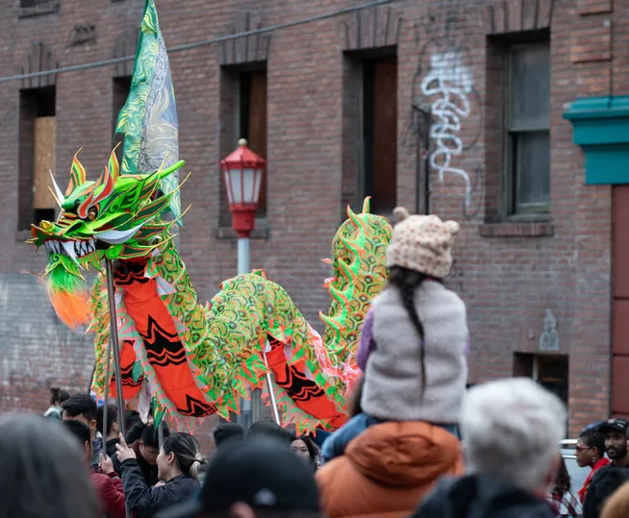
Historic Preservation
The mission of Seattle Department of Neighborhoods is to provide resources and opportunities for community members to build strong communities, receive equitable access to government, and improve their quality of life.
Historic Preservation works in collaboration with communities to preserve places that are identified as important. Keeping a tangible connection with the past helps foster community belonging in the present and future.

Slide 3
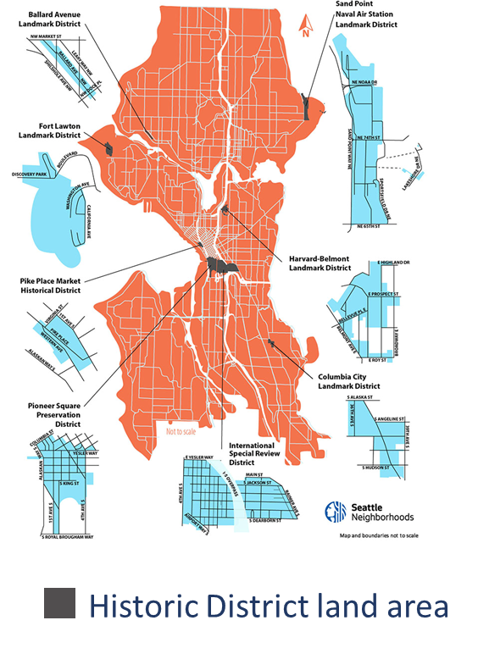
What we do
8 Historic Districts
450+ Landmarks
Coordinate Historic Preservation Boards and Commissions led by community volunteers
Support people through the Landmark nomination and designation process
Manage the Certificates of Approval process
Conduct surveys and inventories of historic resources
Coordinate Major Project Review & Interdepartmental Permitting
Engage community in education, outreach, and storytelling

Slide 4
Designation Standards
In order to be designated, the building, object, or site must be at least 25 years old and must meet at least one of the six standards for designation outlined in the Seattle Landmarks Preservation Ordinance (SMC 25.12.350):
It is the location of, or is associated in a significant way with, a historic event with a significant effect upon the community, City, state, or nation; or
It is associated in a significant way with the life of a person important in the history of the City, state, or nation; or
It is associated in a significant way with a significant aspect of the cultural, political, or economic heritage of the community, City, state or nation; or

Slide 5
Designation Standards, cont.
It embodies the distinctive visible characteristics of an architectural style, or period, or a method of construction; or
It is an outstanding work of a designer or builder; or
Because of its prominence of spatial location, contrasts of siting, age, or scale, it is an easily identifiable visual feature of its neighborhood or the city and contributes to the distinctive quality or identity of such neighborhood or the City.
In addition to meeting at least one of the above standards, the object, site, or improvement must also possess integrity or the ability to convey its significance.

Slide 6
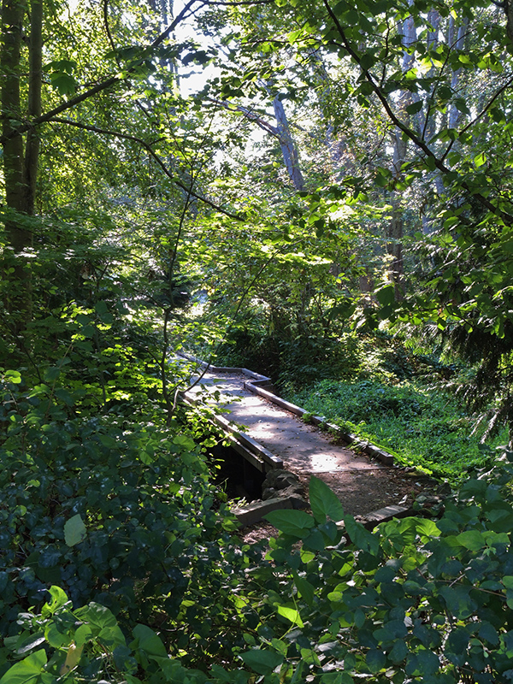
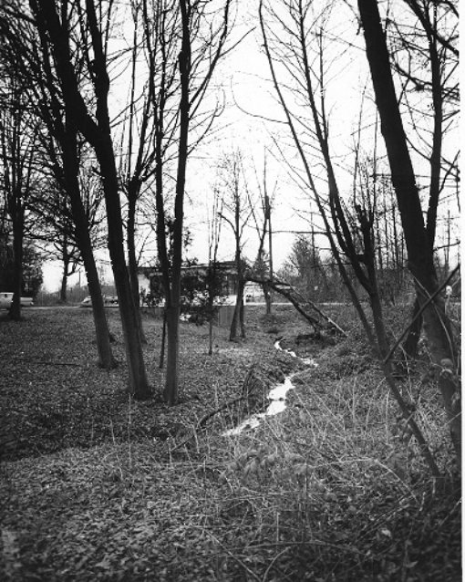
9536 Ashworth Avenue N
líq’tәd - Licton Springs Park
Designation: October 16, 2019
Standards: A and C
Controlled features:
the park site (excluding the existing shelter and play equipment on the west side)
Park Built: 1974
Park Landscape Architects: Jones & Jones
Contemporary photo, 2017
Historic photo, 1961

Slide 7
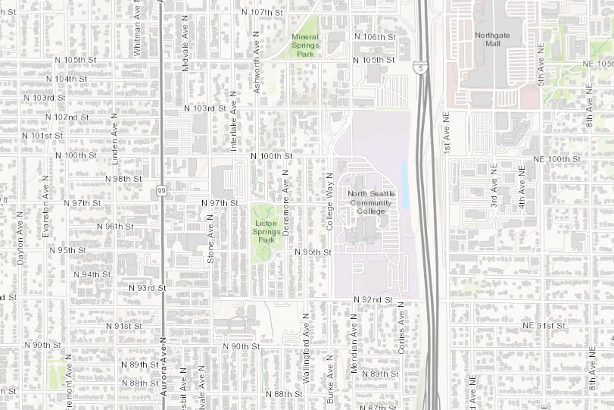
9536 Ashworth Avenue N

Slide 8
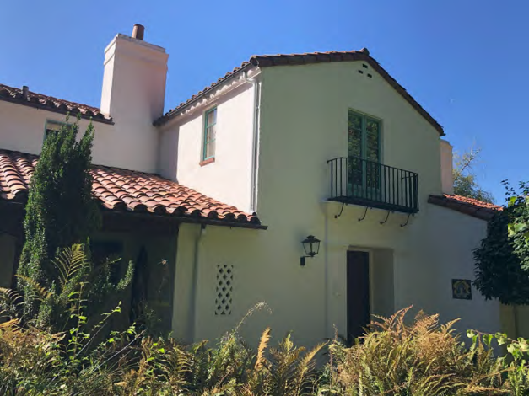
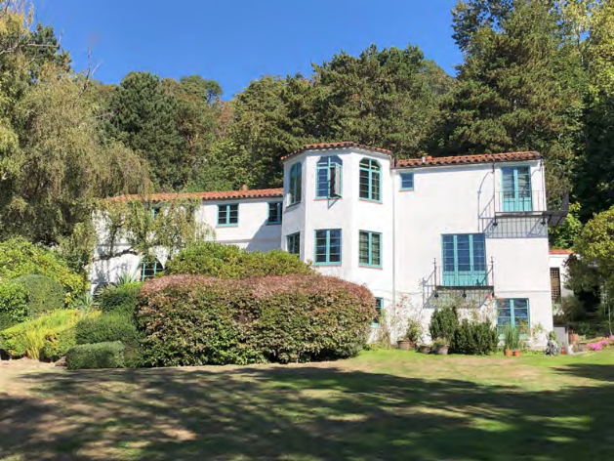
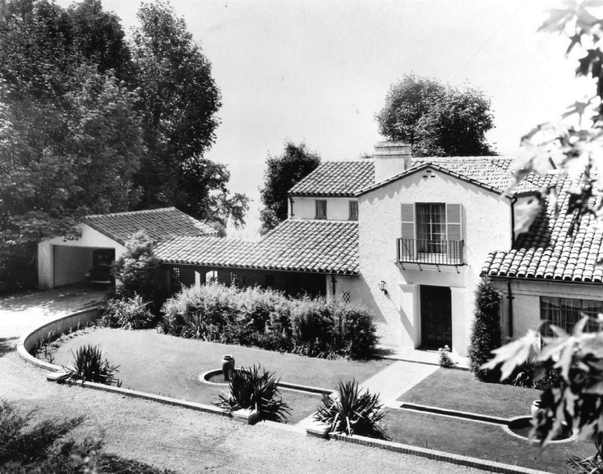
10455 Maplewood Place SW
Stewart House
Designation: November 20, 2024
Standards: D and E
Controlled features:
the site
exteriors of the house and apartment/garage
portions of the interior
Date Built: 1931
Architects: William J. Bain, Sr. and Lionel Pries
Contemporary photos, 2024
Historic photo, 1931

Slide 9
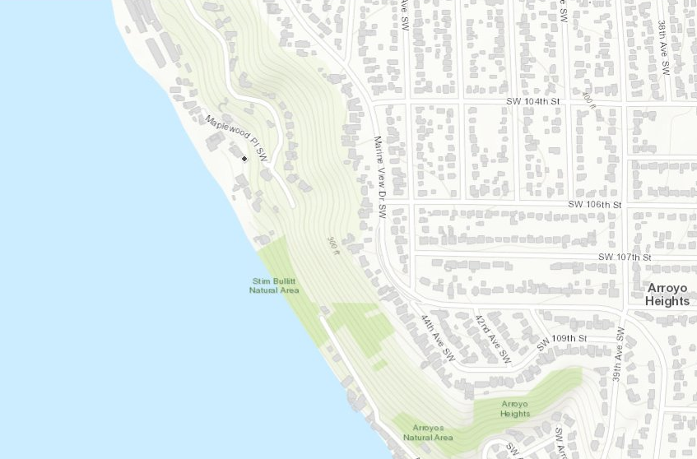
10455 Maplewood Place SW
Puget Sound

