Slide 1
Landmark Designation
HISTORIC PRESERVATION

Slide 2
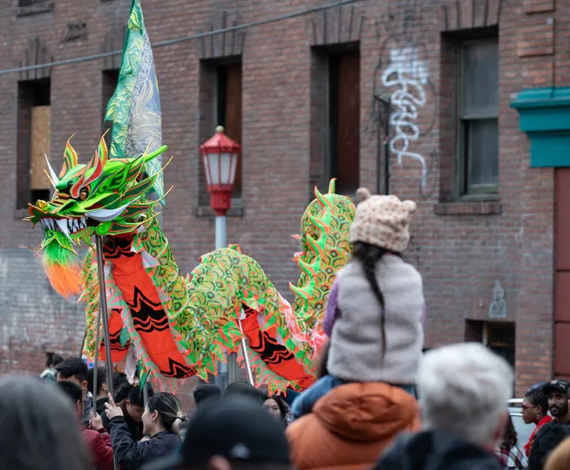
Historic Preservation
The mission of Seattle Department of Neighborhoods is to provide resources and opportunities for community members to build strong communities, receive equitable access to government, and improve their quality of life.
Historic Preservation works in collaboration with communities to preserve places that are identified as important. Keeping a tangible connection with the past helps foster community belonging in the present and future.

Slide 3
Designation Standards
In order to be designated, the building, object, or site must be at least 25 years old and must meet at least one of the six standards for designation outlined in the Seattle Landmarks Preservation Ordinance (SMC 25.12.350):
It is the location of, or is associated in a significant way with, a historic event with a significant effect upon the community, City, state, or nation; or
It is associated in a significant way with the life of a person important in the history of the City, state, or nation; or
It is associated in a significant way with a significant aspect of the cultural, political, or economic heritage of the community, City, state or nation; or

Slide 4
Designation Standards, cont.
It embodies the distinctive visible characteristics of an architectural style, or period, or a method of construction; or
It is an outstanding work of a designer or builder; or
Because of its prominence of spatial location, contrasts of siting, age, or scale, it is an easily identifiable visual feature of its neighborhood or the city and contributes to the distinctive quality or identity of such neighborhood or the City.
In addition to meeting at least one of the above standards, the object, site, or improvement must also possess integrity or the ability to convey its significance.

Slide 5
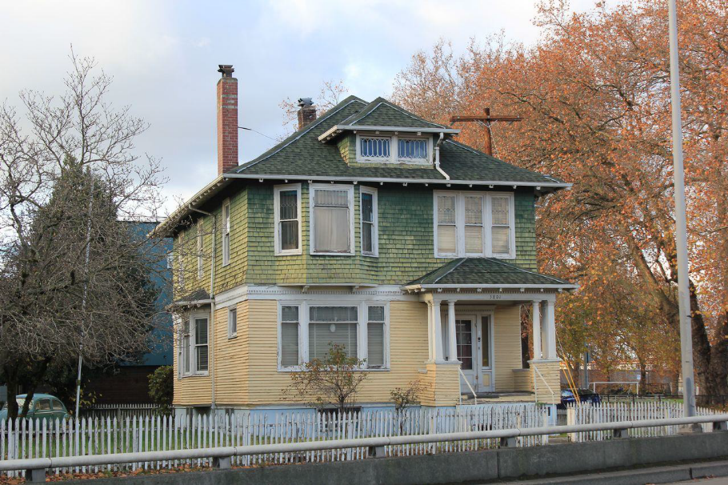
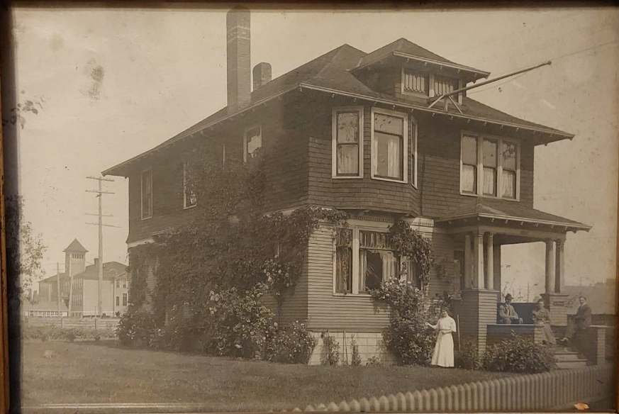
5801 Corson Avenue S
Woodin House
Designation: November 6, 2024
Standard: B, C, D and F
Controlled features:
the site
the exterior of the house
most of the first-floor interior and a portion of the second floor
Date Built: 1904-05
Architect: unknown
Contemporary Photo, 2024
Historic photo, c. 1904-1910

Slide 6
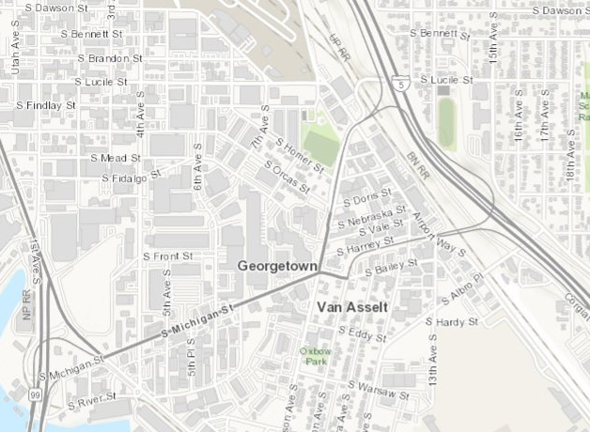
Map
Georgetown/Imogene Woodin Playfield
5801 Corson Avenue S

