Slide 1
2026 Shelter Expansion
Council Bill (CB) 121184
Finance, Native Communities and Tribal Governments Committee
March 30th, 2026

Slide 2
Goal: 1,000 new units of shelter and emergency housing in 2026
Seattle is entering a period of major activity—from a busy summer season to FIFA 2026.
We must accelerate shelter expansion for more people to have a safe place indoors.

Slide 3
Issue Identification
Service providers are burdened with navigating permits, negotiating lease terms, and finding land suitable for standing up new shelter programs.
Many service providers lack background in real estate and working with brokers.
Typical microshelter programs exceed 18k square feet, ranging from 20k to 55k square feet.
7-9 months of delay can occur just in site selection, permitting, and negotiating lease terms.

Slide 4
Policy Overview
Legislation that allows the Finance & Administration Services (FAS) Director greater flexibility in signing lease agreements relating to shelter programs.
Increases the square footage limit from 18k square feet up to 65k square feet.
Removes cost per square foot cap to allow market costs. The existing limit is tied to inflation and would otherwise be capped at $9.50 per square foot.
Enables the City to lease up sites and do initial prep work for raw land.
Impact: This would allow the city to select and prepare sites quickly to be turned over to shelter operators and significantly expedite the opening of new microshelter programs.

Slide 5
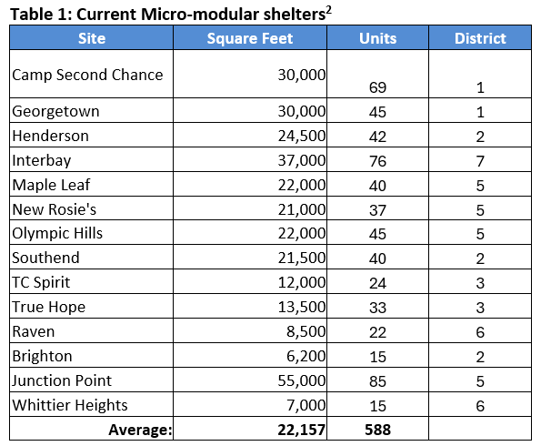
Average Square Footage of Active Microshelters
Table 1: Current micro-modular shelters*
*This list does not include the Nickelsville Central District or Northlake sites, as those two shelters operating under a different model than what is being proposed in the transmitted legislation.

Slide 6
Current process takes ~ 9-12 Months
MO/Council Approves Budget
HSD adds sites to Master Service Agreement with KCRHA
RHA issues RFP to select providers
RHA select providers
Provider has site secured?
Service provider searches for site
Request to RHA
RHA request to HSD
HSD request to depts
If needed, escalation to MO
Site Secured
Hire architect/ contractor
Develop site plan/
Community Engagement
Permitting & utilities coordination
Site development/
Neigh. Agreement
Hire staff to operate site
Operations begin
Streamline provider selection
Shift site preparation from provider to City
City selects service provider
City gets sites to ‘raw land’
Site Selection
Site Development
Provider Selection
Community Engagement
Notes:
NS
Key messages: like sequential to concurrent, shifting the entire burden of setting up the site from provider to city depts/hsd/provider, no kcrha, once sites are selected we can move to site prep in parallel with design and community engagement.
No KCRHA; Pallet Shelter, LIHI, CCS, Love2, Chief Seattle Club; Developer of a larger site if they run a smaller site; operator, culturally appropriate organization, property manager; Pallet Shelters (130th and Aurora, S2);
What assumptions do we want staff to hold while they are doing this? All the policy recommendations? If we assume SEPA exemption, how far can they take the land? If we assume no SEPA exemption, how would they solve this problem? Could we go as far as utility hook-up? Who owns the stuff? The City? The service provider? The contractor? Who is on the lease? Who does the community engagement? What kind of contract would you have to hold to make this work on public property versus private property?

Slide 7
IDT-built process shrinks this to ~3-5 months
City Sites Secured
City gets sites to ‘raw land’
Shelter legislative package is key to unlocking this new process
Develop site plan
Permitting & utilities coordination
Selects contractor to build site
Site development
Final inspections
HSD Selects Service Provider
Service Provider mobilizes
Operations begin
Community Engagement
Site Selection
Community Engagement
Design
Good Neighbor Agreement
Site Selection
Site Development
Provider Selection
Community Engagement
Notes:
NS

Slide 8
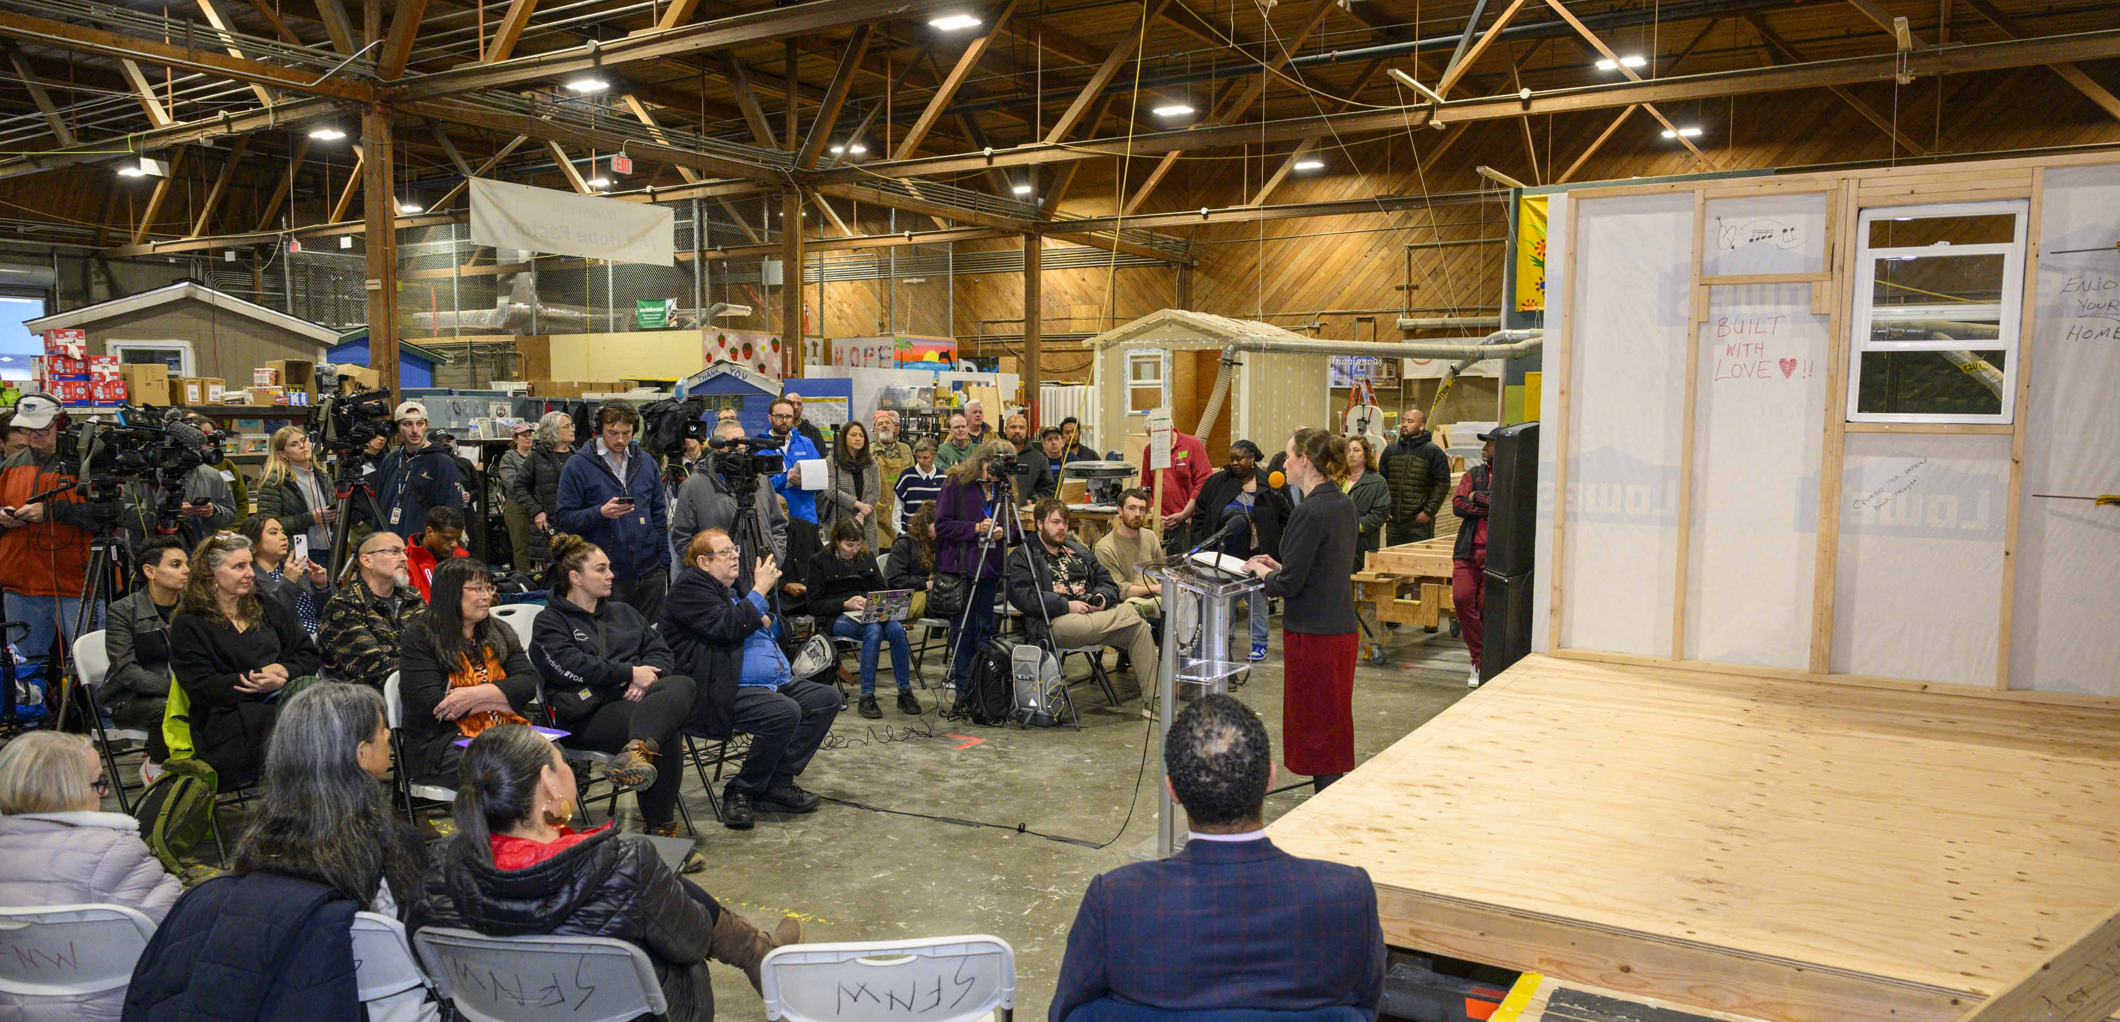
Questions and Discussion

