Slide 1
CB 121225:
Information Technology
Talent Modernization
Human Services, Labor, and Economic Development Committee
July 17, 2026

Slide 2
Presentation Agenda:
1 |  | Talent Modernization Overview
2 |  | Purpose of Proposed Legislation
3 |  | Current State
4 |  | Project Objectives
5 |  | Financial Impacts
6 |  | Next Steps

Slide 3

Overview
I’m 30 years old
What is Talent Modernization?
What are the current challenges?
Multi-year effort to modernize the City of Seattle’s classification and compensation structures for IT positions.
This effort is to more accurately and clearly reflect the bodies of work performed and match them to industry standards.
It is a partnership with Seattle Human Resources, Seattle IT, and Labor.
Compensation program created in 1997 (nearly 30-year-old system).
There is no classification structure (no domains or levels).
Cannot easily match to industry standard.
Does not allow for easy analysis of future technology jobs ​trends

Slide 4

Purpose of Proposed Legislation
Creates a new IT classification structure that defines technology roles by disciplinary domain and level of responsibility.
What it does NOT do:
  Legislation does not implement new classifications or compensation programs, nor does it modify the existing ITP classification structure.
Legislation establishes only the foundational structures for the necessary classification title development, compensation grade assignment, pay structure, in order to conduct labor negotiations.

Slide 5
Project Objectives
Consistent Pay Practices: Adjusting pay more easily to market changes
Retention and Satisfaction: The transparent path to higher pay improves employee morale and loyalty.
Administration: Easier for management to justify and for administrators to manage.
Reduced Bias: Because increases are based on time or objective, predefined milestones rather than performance ratings, it reduces pay disparity issues.
Budget Consistency: Organizations can more easily negotiate with unions, and it is easier to forecast budget changes.
Notes:
Step progression pay structures provide for wage progression based on length of service, rewards tenure, and experience within the organization.

Slide 6
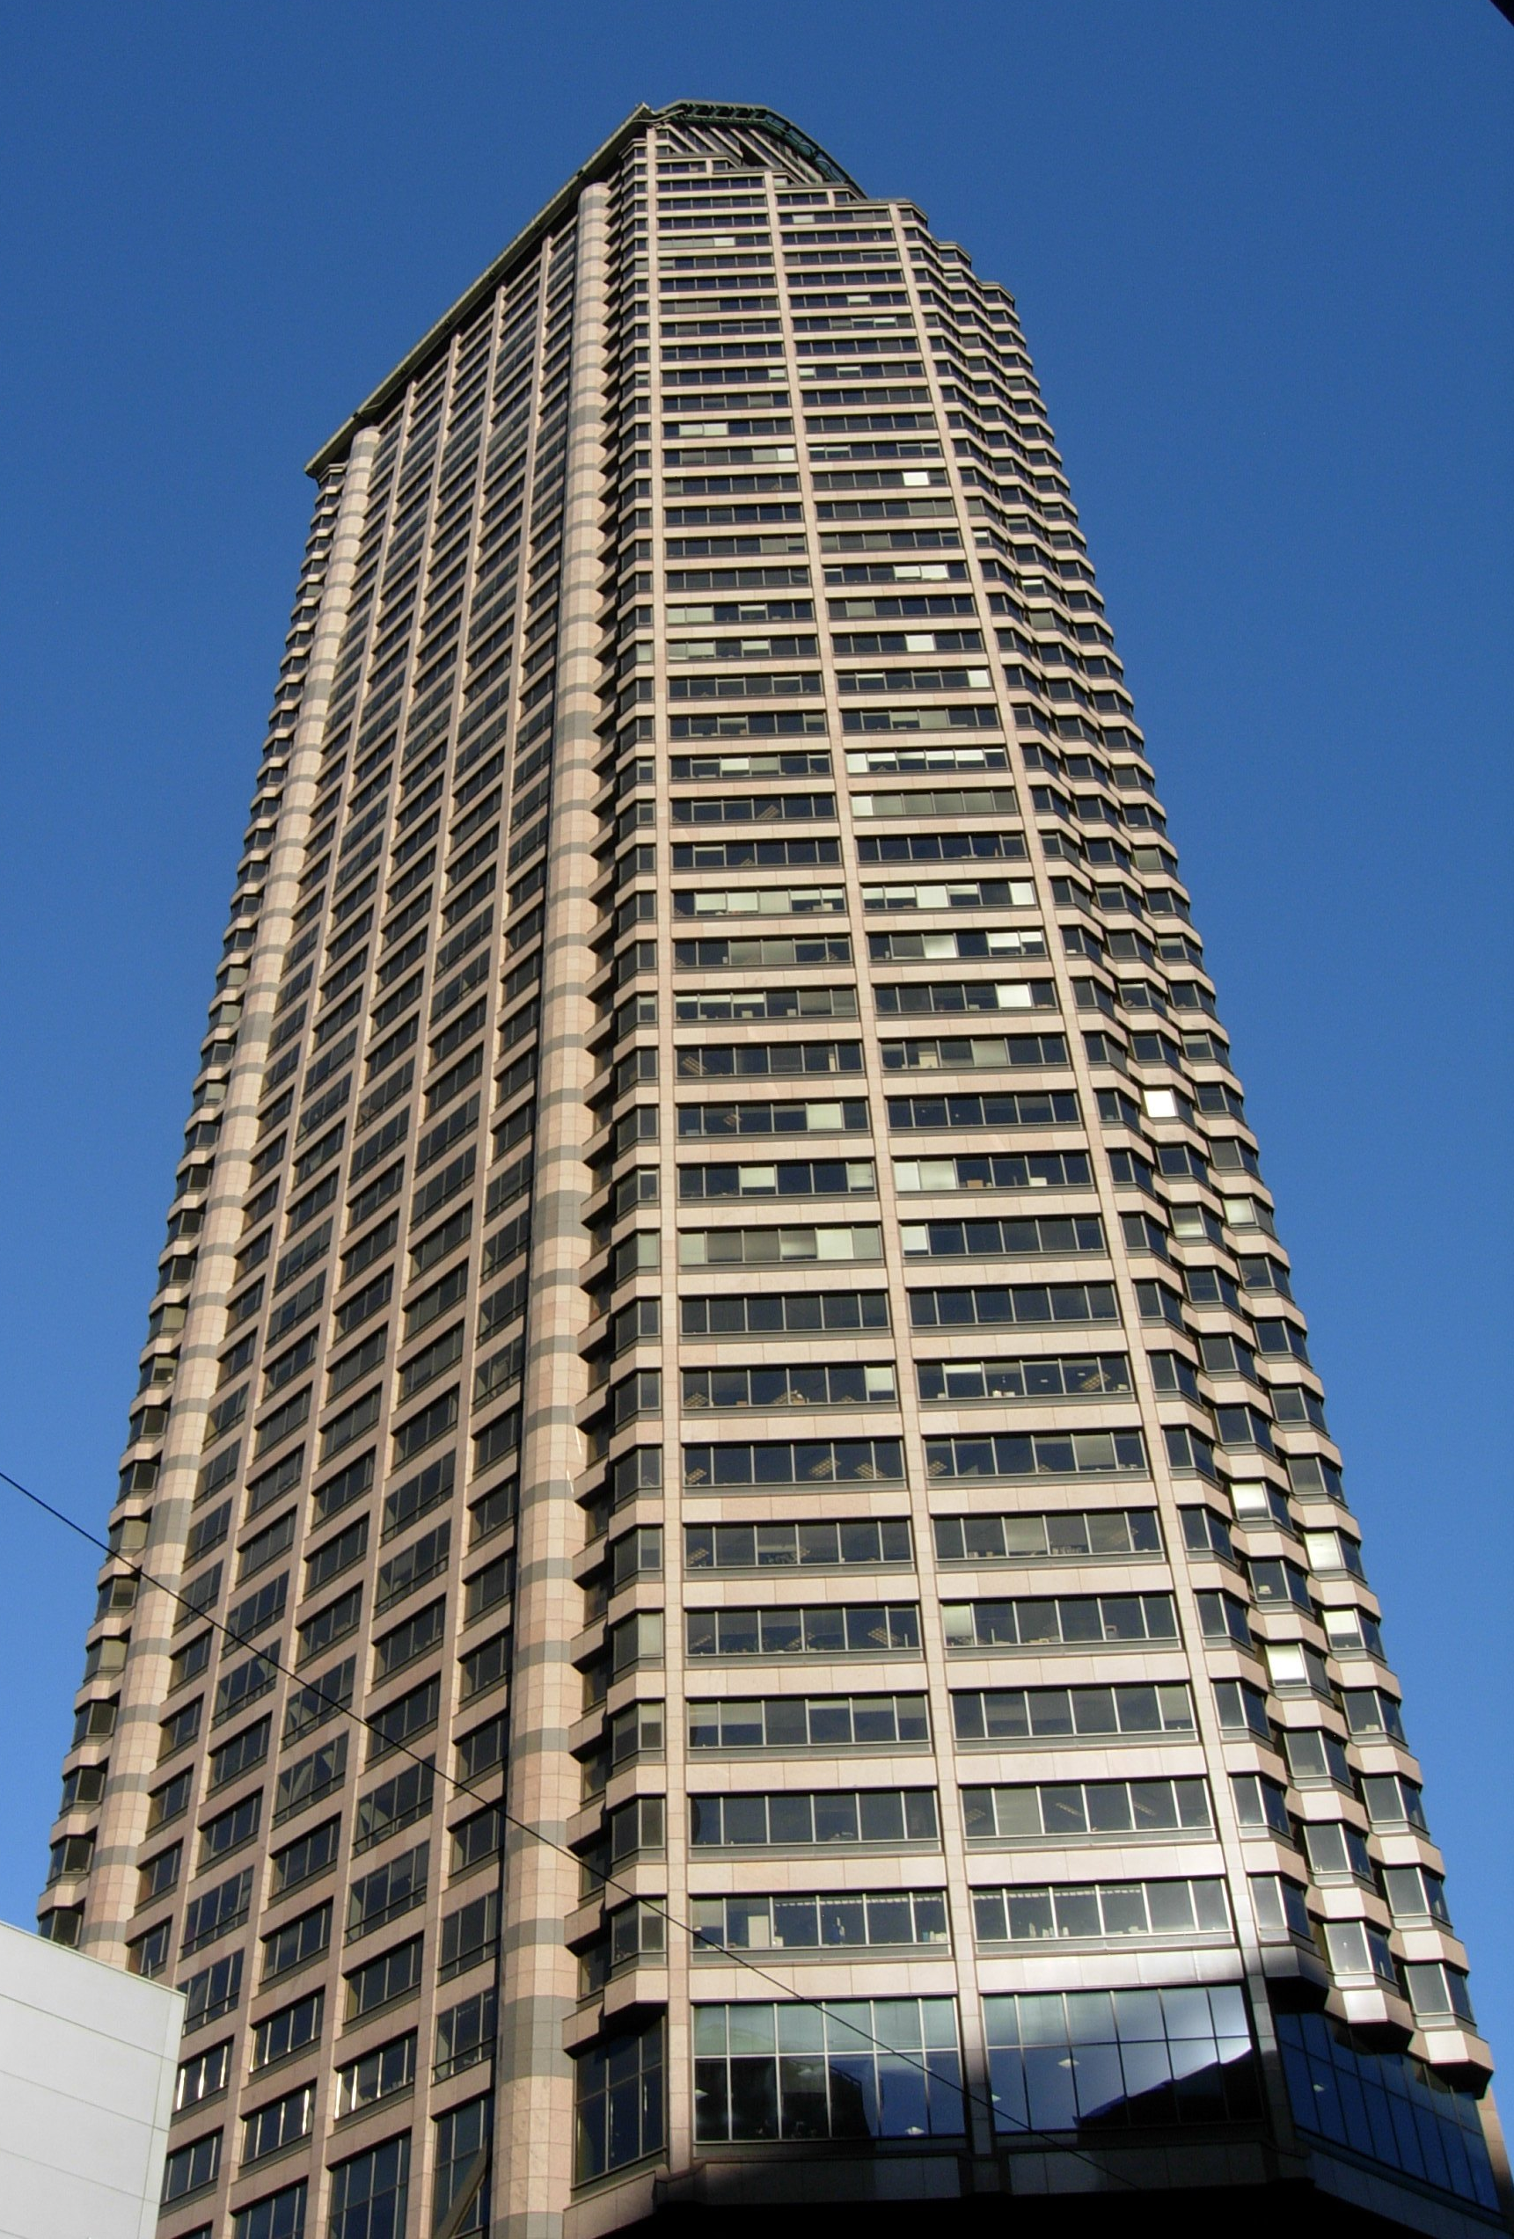
Financial Impacts
There likely will be financial impacts when employees are placed into this new structure, but those impacts cannot be determined at this time and would be subject to bargaining. Any potential downstream financial impacts of moving employees into the new structure would be presented to Council as part of Collective Bargaining Agreement with L77 ITP.

Slide 7
Next Steps
Council action on CB 121225 establishes a new IT classification structure and provides a foundation for future legislation.
Prepare for Bargaining
Future Legislation Once Negotiations are Complete
Implementation of Bargained Structure

Slide 8
Thank you
CB 121225:
Information Technology Talent Modernization

