Slide 1
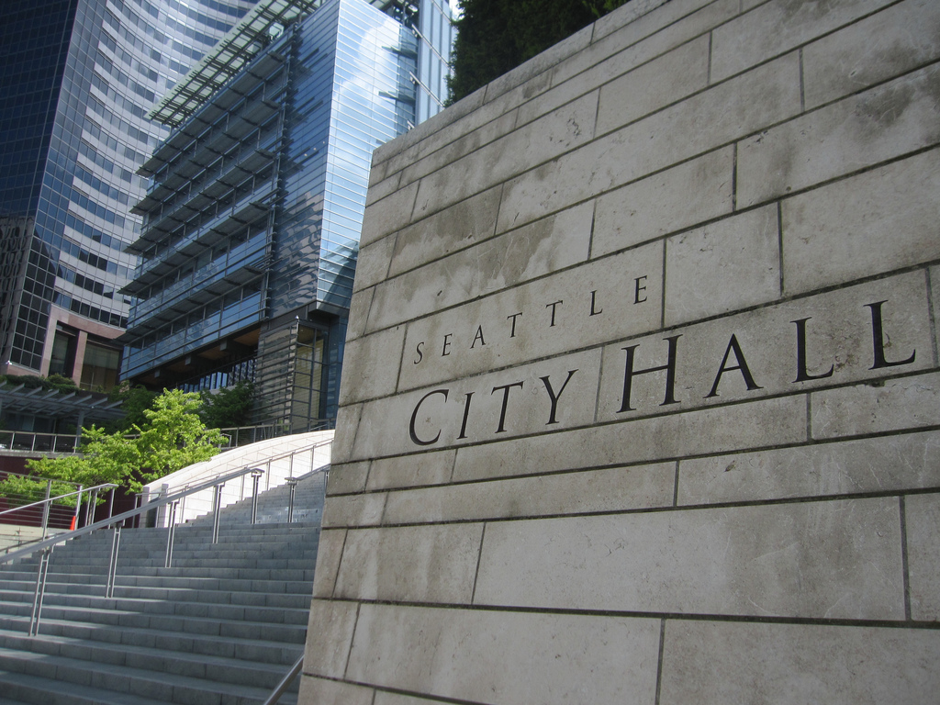



Civil Service Status Changes
CB 121284
Seattle City Light, Seattle Public Utilities, and the Seattle Municipal Court
September 18, 2026
Employee partnership, equity, experience, community
Date (xx/xx/xxxx)
Department Name
Page Number
Employee partnership, equity, experience, community
‹#›

Slide 2
Seattle Public Utilities
Moving Two Positions Out of the Civil Service
Seattle City Light
Moving Two Positions Out of the Civil Service
Seattle Municipal Court
Strategic Advisor 3 to Executive II
Strategic Advisor 3 to Executive II
Strategic Advisor 1 to Executive I
Manager 3 to Executive II
Bailiff to Court Clerk
Moving Seven Positions Into the Civil Service
Agenda

Slide 3
Civil Service Status Changes
Kavya Setty, Talent Acquisition and Compensation Manager

Slide 4
Agenda
What the prior positions did
What the new positions do
Why the change was requested
Impacts on employees
Budget impacts

Slide 5
Summary
Prior Classification: Strategic Advisor 2
New Classification: Executive 1
Key changes in scope:
  Leads People & Culture Operations, Talent Acquisition, Compensation & Classification, Workforce Systems, Analytics, Compliance
  Manages 6 leaders and indirectly 19 staff
  Executive‑level policy influence across the utility
Budget Responsibility:
  $49M strategic oversight
  $2.25M direct management

Slide 6
Summary
Prior Classification: Manager 3
New Classification: Executive 2
Key changes in scope:
  Leads engineering workforce (~24 employees)
  Oversees joint‑use make‑ready work, pole replacements, regional infrastructure upgrades
  Sets policy and ensures NESC/WAC safety compliance
Budget Responsibility:
  $3.5M O&M budget
  $56M CIP program

Slide 7
Employee Impacts
Aligns classification with expanded executive‑level responsibilities
Supports retention and leadership continuity
Reduces operational and safety risks
Strengthens organizational performance and decision-making

Slide 8
Budget Impacts
Executive 1: +$11,027 midpoint change
Executive 2: +$28,983 midpoint change
Total SCL Impact: +$40,009
Fully absorbed within the existing Light Fund budget

Slide 9
Summary
Both positions significantly expanded beyond prior classifications
Executive classification ensures proper authority, accountability, and compensation
Changes strengthen leadership, safety, and operational performance
No additional appropriation required

Slide 11
Civil Service Status Changes
Adrienne Thompson, Human Resources Division Director

Slide 12
Position Information
In 2025, Seattle Public Utilities (SPU) submitted Executive Job Summary Questionnaires (JSQ) for its Government Relations & Legislative Affairs Division Director and Corporate Policy & Planning Division Director positions to request designation to Executive Titles.
Government Relations & Legislative Affairs Division Director (#10007390) –
  Advances SPU’s mission, goals, policies, and priorities by collaborating with federal, state, regional, and local agencies and builds trusted relationships with Tribal Government and other partners.
Corporate Policy & Planning Division Director (#00022632) –
  Advances and drives SPU’s Community Centered vision that’s consistent with the City’s broader vision for community capacity building and engagement;
  Leads cross SPU strategy development, innovations, and problem solving to advance SPU’s Community Centered - One Water - Zero Waste vision.

Slide 13
APEX Criteria
The two Division Director roles and responsibilities align with the Executive Title:
  Broad corporate responsibilities and accountability extends across SPU, citywide and with external partners.
  Make significant policy recommendations to elected officials at federal, state and local government. Policy recommendations impact long-range City goals and objectives.
  The range of authority of these positions are Citywide, regional, state, and federal. Programs impacted by these positions affect the delivery of critical services, quality of life for residents, and effective allocation of funding.

Slide 14
Why Civil Service Exempt
  SPU requests for these positions to be exempt from Civil Service:
  Based on the level of responsibilities and impact, these positions require a confidential relationship with SPU’s General Manager & Chief Executive Officer.
  Incumbents are required to possess a high-level of individual accountability to meet their position’s goals and priorities.
  Executive positions are exempt from Civil Service under SMC 4.13.010.

Slide 15
Impacts
Body of Work: Employees will continue to perform their existing body of work.
Budget: There will be minimal budget impact for SPU. Both employees are presently at the top of the SA 3 pay band. Designation to the Executive 2 level will make them eligible for incremental increases not to exceed the top of the Executive 2 salary band.

Slide 16

Civil Service Status Changes
Dwayne McClain, Deputy Court Administrator – Administrative Services

Slide 17

Prior Title: Bailiff
Supported courtroom operations by carrying out judicial directions and coordinating daily workflow.
Served as liaison among judges, defendants, attorneys, jurors, marshals, and court partners.
Facilitated remote and in‑person hearings.
Prepared and processed legal documents for jail commitments, releases, and sentencing.
Oversaw care and custody of jurors; maintained confidentiality and professionalism. Provided impartial, culturally aware customer service and adapted to changing laws and technologies.

Slide 18

New Title: Court Clerk
Listen to, summarize, and record judicial actions, rulings, pleas, and sentencing.
Prepare and file motions, briefs, and official court documents.
Review and assemble case files for hearings; operate and host remote hearings.
Coordinate transport and supervision of in‑custody individuals; process jail commitments and releases.
Summarize proceedings for other courts and City departments.
Maintain custody and care of jurors; cross‑train other clerks.

Slide 19
Why the Change & Impacts
Reason for Change: Return to Civil Service
Impacts on Employees
Budget/Fiscal Impact
Bailiff was a civil‑service‑exempt classification.
Reclassification to Court Clerk requires returning positions to classified civil service.
Aligns these seven positions with all other Court Clerk roles at SMC.
Work continues but under the correct classification
Ensures consistency, equity, and alignment with all Court Clerk positions
No negative personnel impacts identified; supports accurate role definition.
SMC has already absorbed the cost of reclassifying these positions.
Mid‑point cost difference per position: $6,389.
Total SMC cost absorbed: $44,721.
No additional appropriation required.

Slide 20
Thank you
Dwayne McClain
Deputy Court Administrator, Administrative Services
dwayne.mcclain@seattle.gov
www.seattle.gov/courts

