Slide 1
Restoration Ecologist
Position Reclassification
CB 121286
Lisa Ciecko, Ecology Team Manager
September 18, 2026
Human Services, Labor & Economic Development Committee

Slide 2
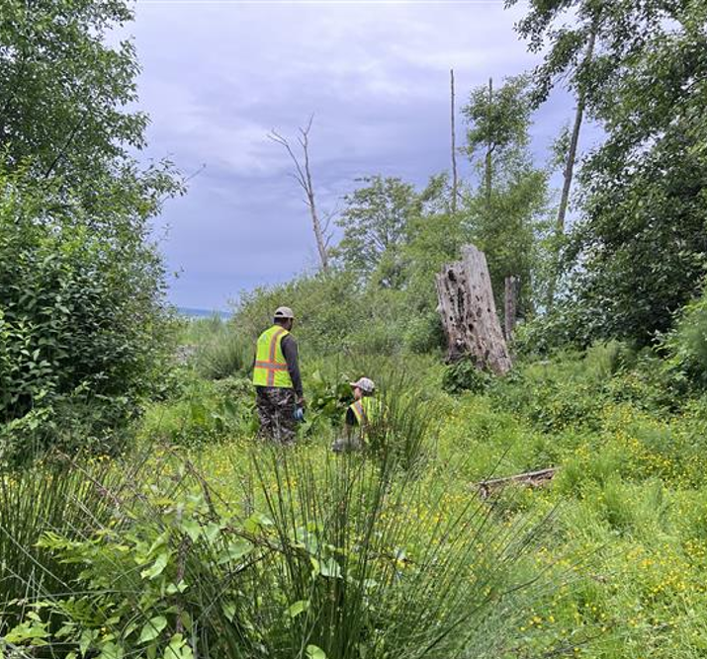
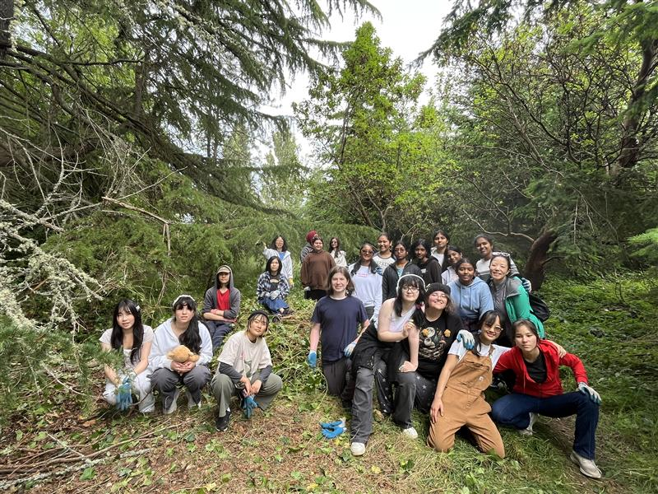
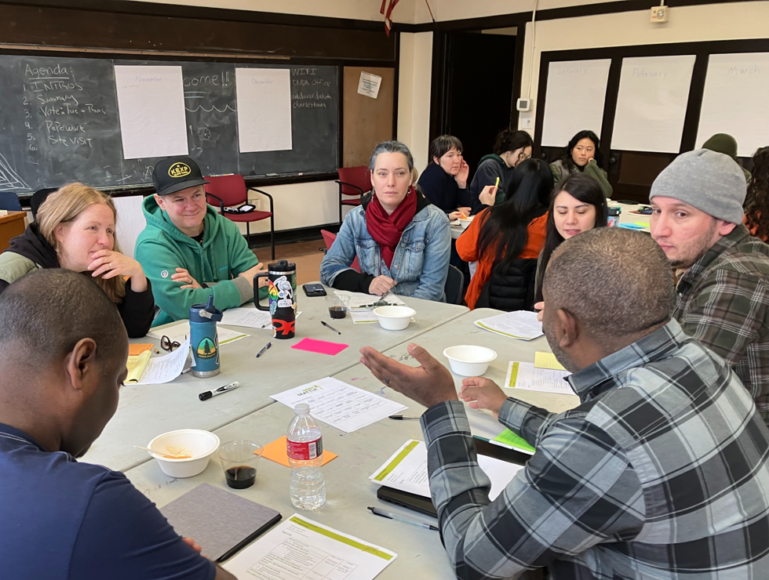
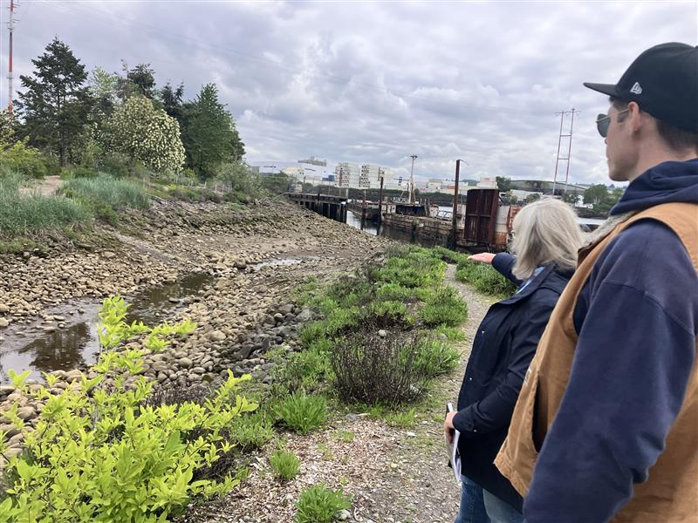
Purpose
The scope of Seattle Parks and Recreation’s ecological restoration programming has expanded, requiring a higher level of skill for staff implementing and leading these programs. In response, this legislation:
retitles the Plant Ecologist job title to Restoration Ecologist,
creates a Senior Restoration Ecologist title, and
establishes pay rates for both titles.
Agenda
Overview of Proposed Changes
Overview of Community and Employee Benefits
Position Change Summary
Q&A

Slide 3
Classification Comparison
Current
Proposed
Plant Ecologist
Designs, plans, implements, and evaluates a comprehensive vegetation management
Develops scopes of work and budgets for professional contracts
May produce research, statistical analysis, and write reports
Engages with immediate staff and regulatory agencies; meets with public to share project information
Restoration Ecologist:
Includes all duties outlined for Plant Ecologist
Provides technical guidance on terrestrial and aquatic habitat
Participates in community engagement, volunteer coordination, and public education related to the City’s ecosystem health goals
Restoration Ecologist, Senior:
Functions as project lead on complex or multi-site ecological restoration projects
Develops goals and monitoring programs in line with ecological restoration principles
Fosters partnerships across departments and with external organizations and community groups

Slide 4
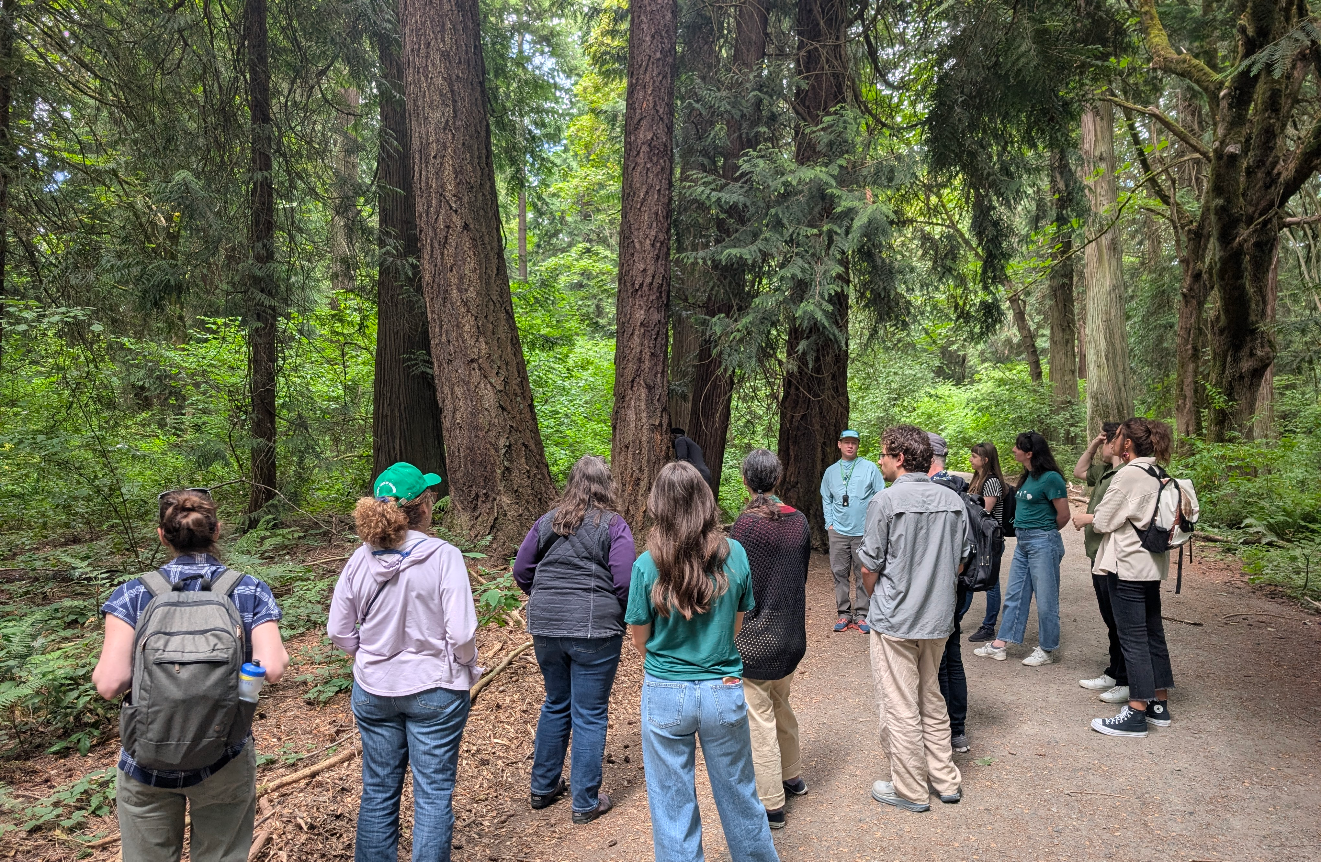
Benefits
Employee
Updates the classification to better align with the growing professional field of Restoration Ecology.
Creates a career progression path.
Aids recruitment for two positions currently vacant.
Community
Increases the City’s capacity and effectiveness in delivering ecosystem restoration commitments to community.
Affirms ecosystem health, livability, and climate justice as a shared priority with city residents.

Slide 5
Position Change Summary
Proposed Changes to Job Titles & Rates of Pay:
Current Classification | Proposed Classification | Number of Positions | Proposed Rates of Pay
Plant Ecologist | Restoration Ecologist | 1 | $43.12 – $50.33 (No Rate Change)
Plant Ecologist | Senior Restoration Ecologist | 2 | $47.38 – $55.19
Fiscal Impact:
Anticipated ~$23K annual impact to Green Seattle Partnership line of business to be covered within existing budget.

Slide 6
Questions?
Notes:
Presenter: Lisa Ciecko
Thank you for the presentation time today. Now we are happy to answer any questions you may have.
Council may ask:
What was the basis for determining the pay for the Senior positions?
A market review study was done by SDHR - Salary recommendations based on a review of available market data sources. Due to differences in classification design, including the use of extended step systems and varying career progression models, market data was used as a reasonableness check, with primary emphasis placed on internal alignment, step progression and consistency within the City’s established compensation framework.
For example, did SDHR use a standard percentage increase for classifications with more responsibility or did SDHR perform a market study? If the latter, what other jurisdictions were studied? The current pay assigned to the Plant Ecologist is within range of the reviewed market data. This placement is based on step alignment and midpoint considerations, with the entry rate for salary grade 330 overlapping the upper portion of the journey level range and providing a logical progression that reflects advanced technical expertise and increased complexity.

