Slide 1
Ballard BIA
Ordinance Amendment
Office of Economic Development
Casey Rogers, Business Improvement Area Policy Advisor

Slide 2
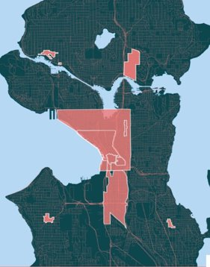
Seattle’s Business Improvement Area Program​
11 BIAs in Seattle generate more than $45 million for enhanced business services and programs​
Local control, predictable and sustainable funding ​
Revenue collected is 100% allocated to the district ​
Program is supported by OED and Treasury Services

Slide 3
Seattle’s BIA Program​
Each BIA has its own unique ordinance describing the assessment methodology
Inflationary factors are commonly used in BIA assessment formulas to ensure that budgets keep in pace with economic conditions and keep up with the cost of providing services

Slide 4
Proposed Amendment Summary
Clarifies ambiguous ordinance language regarding how annual inflation adjustments should be applied
Confirms the intended method: yearly increases in Years 3–12 must be based on the previous year’s assessment plus the Seattle CPI‑U change from October to October, with a 2% minimum and 6% maximum increase.
Provides CPI-U "backup": includes language outlining what to do if the October CPI-U Seattle index is unavailable

Slide 5
Proposed Amendment Summary continued
Does not change the assessment methodology—only clarifies it to prevent misinterpretation.
Ensures consistent calculations, aligns future years with Year 2, and reduces administrative complexity and risk of errors.
Improves transparency and predictability for ratepayers.

Slide 6
Conclusion
OED recommends approval, finding the amendment reasonable, aligned with City BIA policy, and necessary for accurate implementation.

Slide 7
Questions?
Notes:
CG

