Slide 1
Capitol Hill (Broadway) BIA Ordinance Amendment
Office of Economic Development
Casey Rogers, Business Improvement Area Policy Advisor

Slide 2
Background
The Capitol Hill Business Improvement (CHBIA) Area was originally established in 1986
CHBIA’s business‑based, self‑reported revenue model leads to unpredictable budget, sensitivity to business closures, and the $3,500 cap limits growth and erodes service capacity.
Rising costs for cleaning, safety, and district management have outpaced assessments, leading to cutbacks in core services.

Slide 3
Background (continued)
The proposed amendment offers short‑term budget stabilization by adjusting rates for inflation and making a small boundary correction
Increased fixed assessments improve equity across ratepayers
Longer term, CHBIA plans to evaluate shifting to a more predictable, sustainable property‑based assessment model aligned with current city practice

Slide 4
Amendments to Assessments
Raise the maximum annual assessment from $3,500 to $5,000 to help cover higher service costs.
Increase Seattle Central College’s fixed assessment by removing its special lower rate so it pays the standard maximum rate.
Increase financial institutions’ fixed assessment so they also pay the standard maximum rates
Starting in 2032, add a steady $200 yearly increase to the maximum assessment to keep up with inflation.

Slide 5
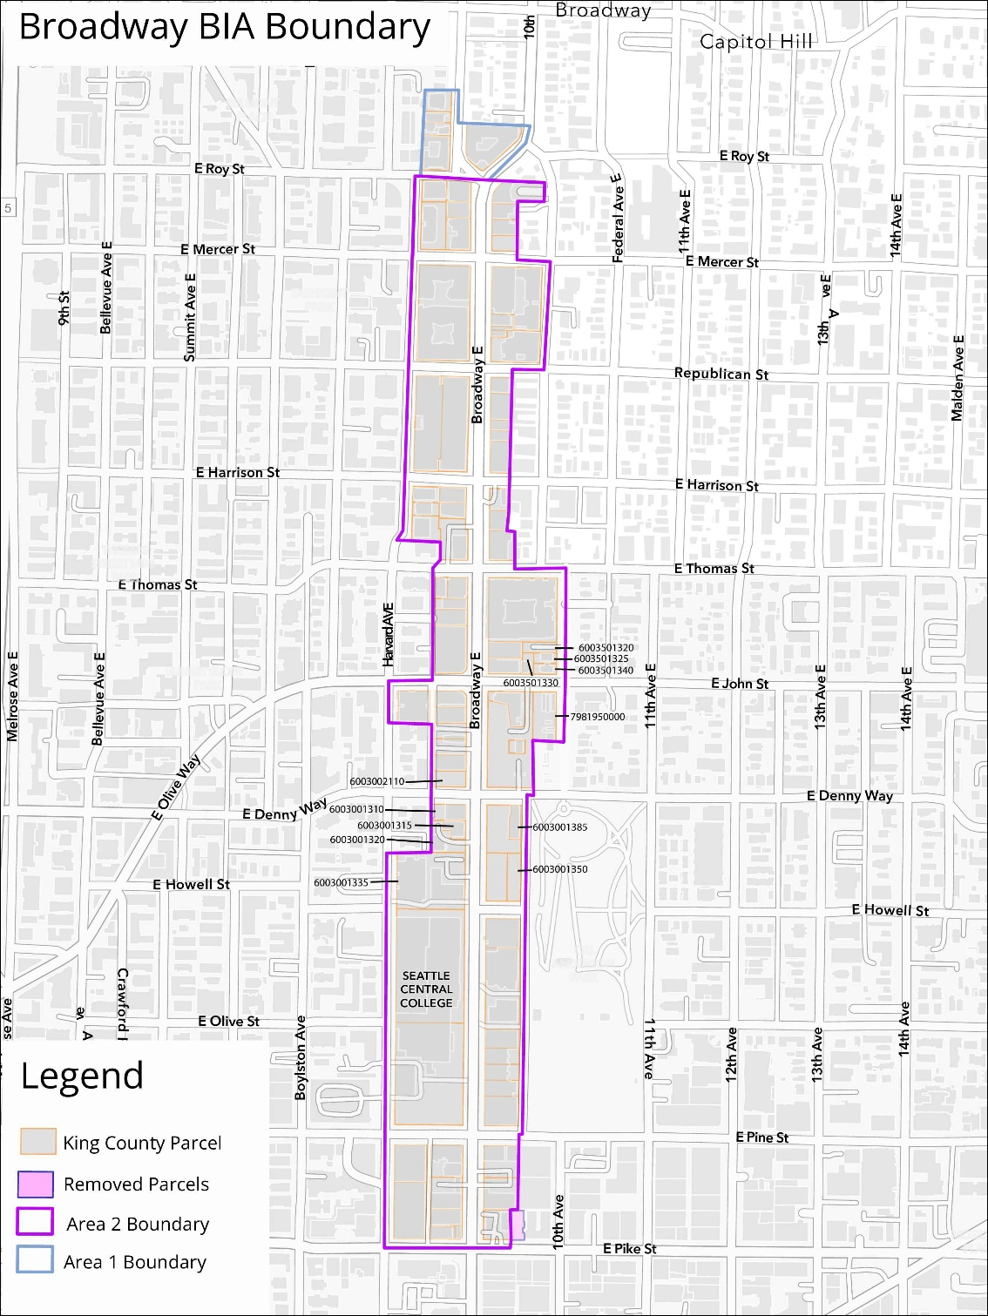
Boundary Change
Remove the parcel at 910 E Pike Street from the CHBIA boundary to better match the actual commercial area
Notes:
Note: that the map of the proposed new BIA boundaries (exhibit A) was updated to align with the legal description in the ordinance, which is accurate. The boundaries in the map from the previous amendment were incorrect; this was a correction, not a boundary change.

Slide 6
Conclusion
OED recommends approval, finding the amendment reasonable, aligned with City BIA policy, and necessary for accurate implementation.

Slide 7
Questions?
Notes:
CG

