Slide 1
Mandatory Housing Affordability (MHA) in Chinatown/International District
PLUZ Committee Briefing
May 2, 2017

Slide 2
Context
2011 Livable South Downtown
Incentive Zoning & Transfer of Development Rights
Ongoing Growth & Investments
Commercial Stabilization
2017 CID Framework & Implementation Plan
MHA in the CID Context

Slide 3

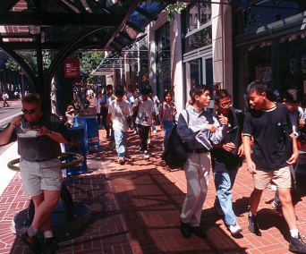

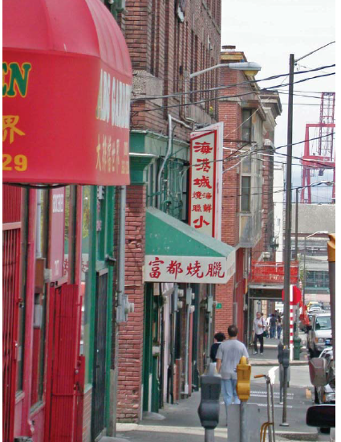
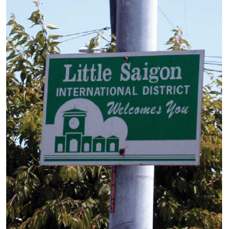
2011 Livable South Downtown

Slide 4
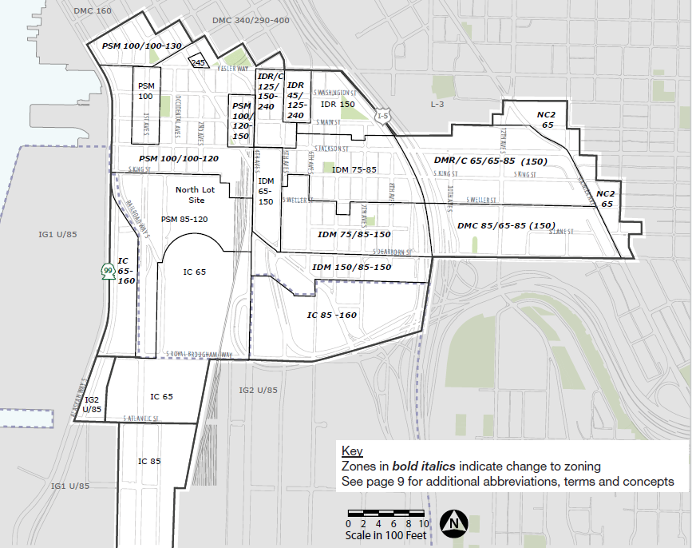
Zoning changes

Slide 5
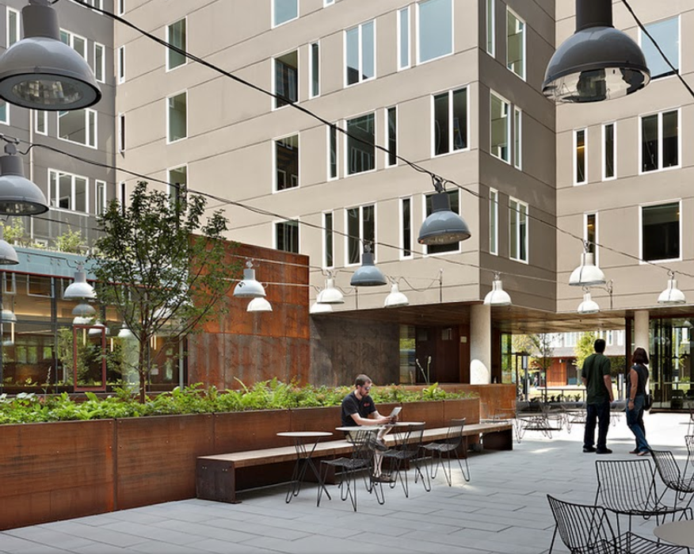
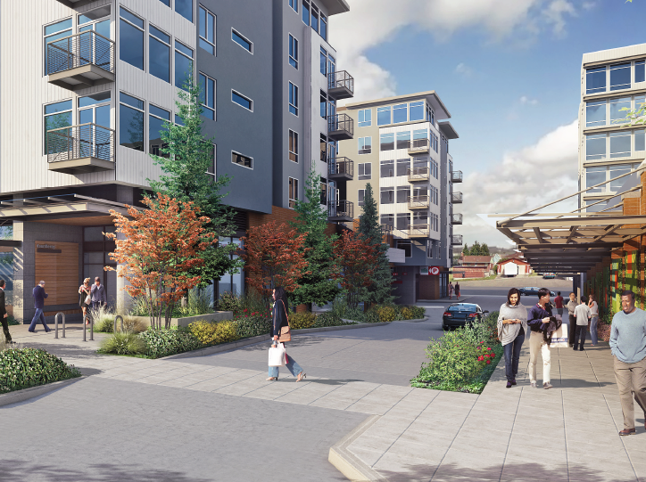
Incentive Zoning
In addition to affordable housing, to reach the maximum heights projects must:
  Acquire TDR from open space, landmarks,
  Provide Privately Owned Public Space (POPS); or
  Provide green street improvements
Commercial properties also contribute to childcare

Slide 6
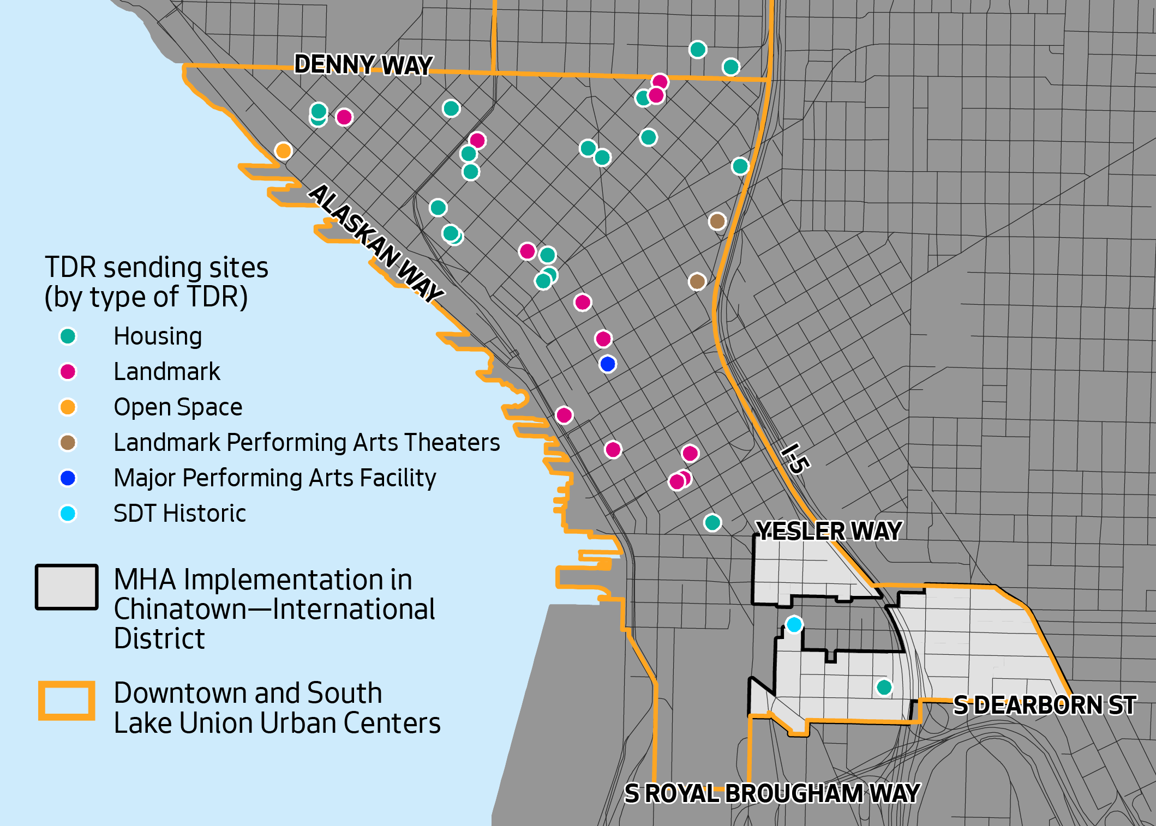
TDR Sending Sites

Slide 7
Transfer of Development Rights
Potential amount of TDR that could be transferred is substantial more than 20 year demand
Amount of TDR actually available for sale at any time varies

Slide 8
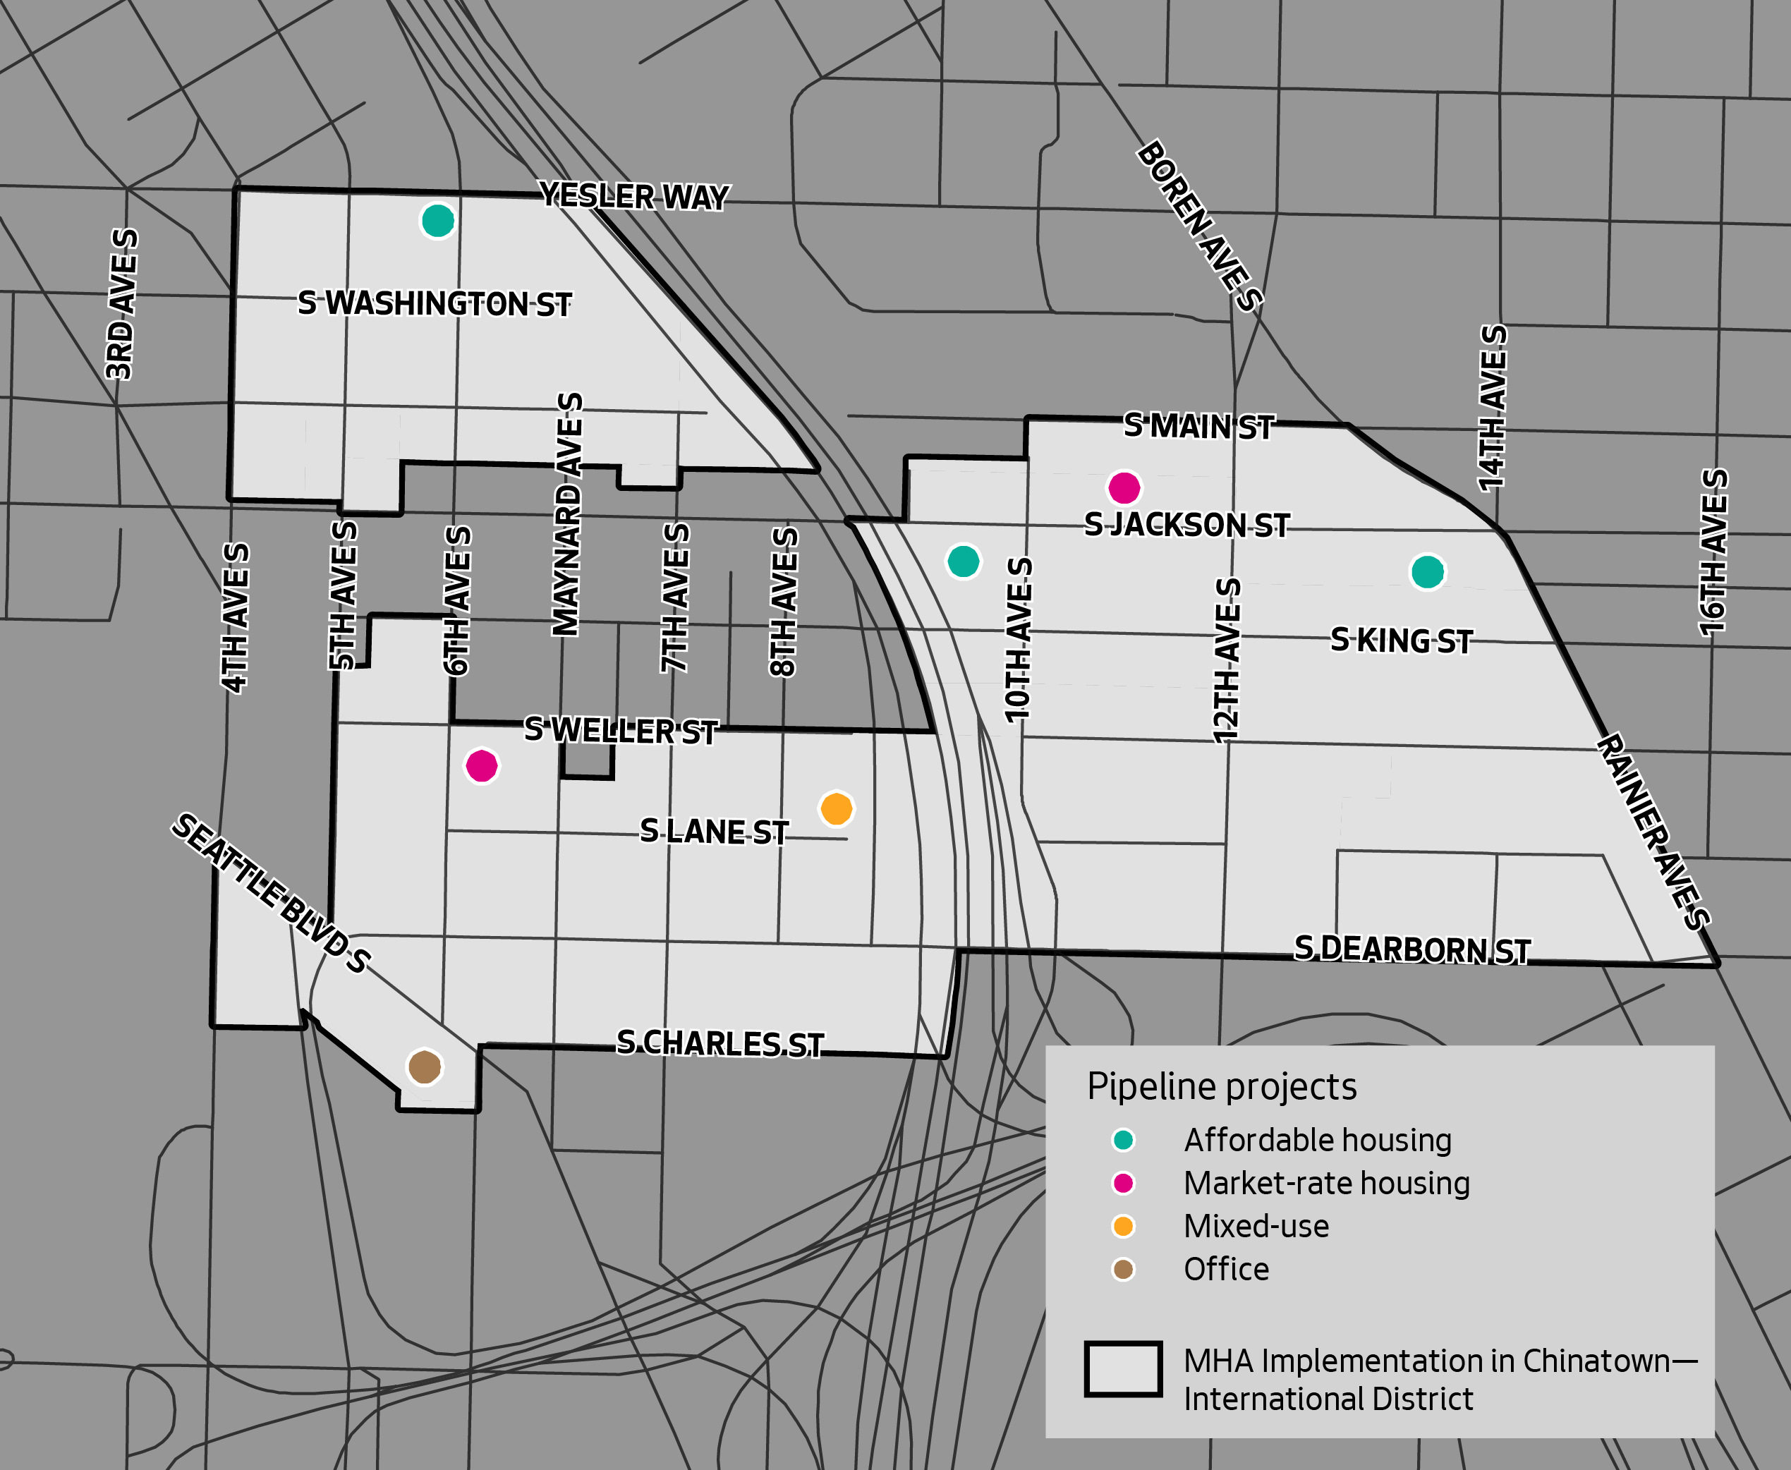
Pipeline
Notes:
Opt-in

Slide 9
Investments
Hing Hay Park Expansion
Landmark Project
Street Concept Plans and Improvements
One Center City
Center City Connector
Crosswalk, Greenway, and Bike Lane Improvements

Slide 10
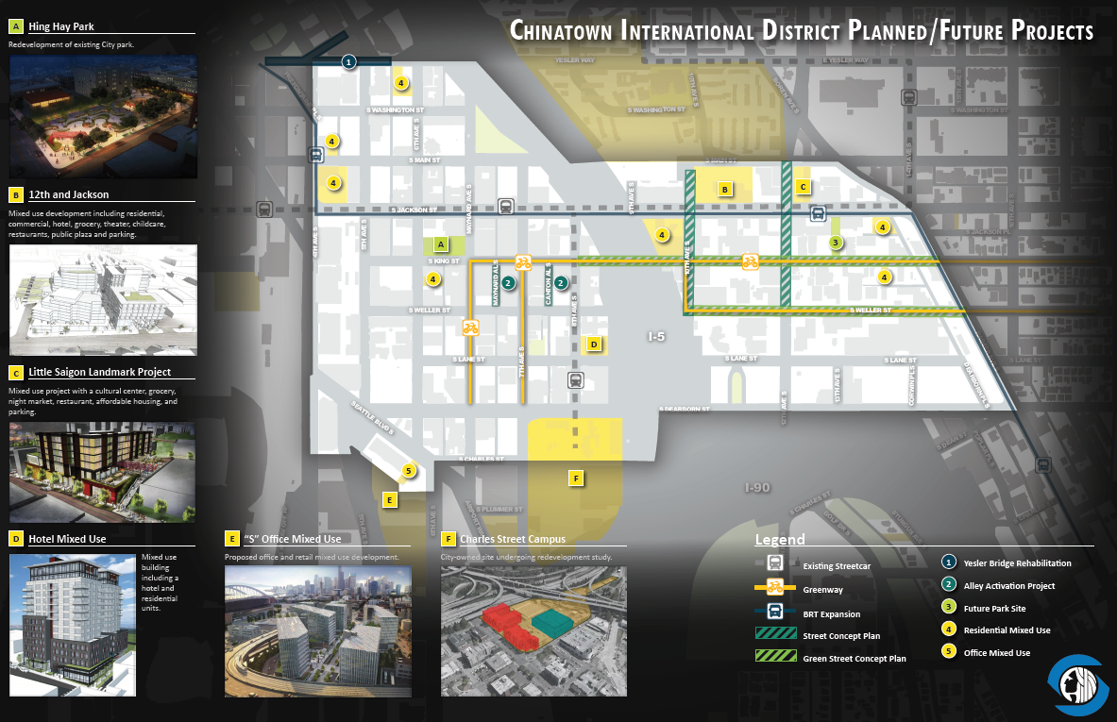
2017 CID Framework & Implementation Plan

Slide 11
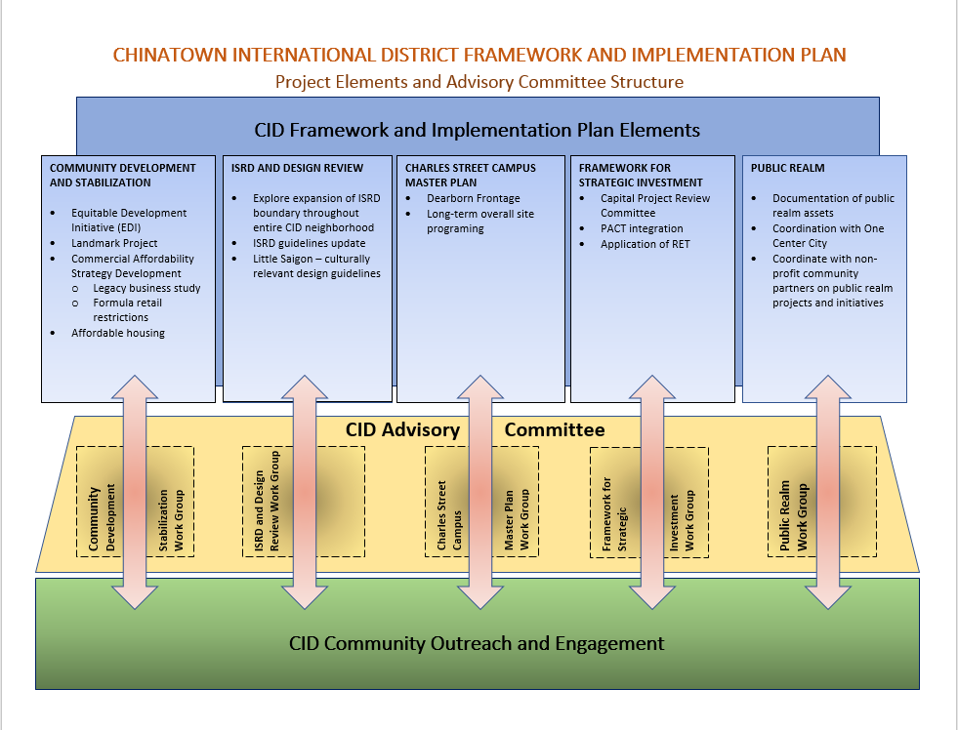
2017 CID Framework & Implementation Plan

Slide 12

Commercial Affordability
Working Through Task Force Recommendations
Legacy Businesses study
Business Consulting Team
Exploring recommendations
  Permitting, Affordable housing
  policy, Retail design
Exploring opportunities with
city-owned properties

Slide 13

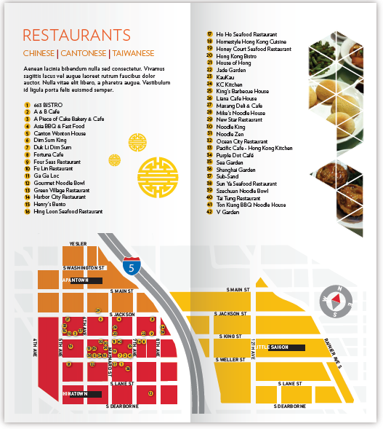

Neighborhood Business Districts
Investing in CID business district (Only in Seattle)
Organizing around an Action Plan
Retail retention and recruitment
BIA expansion
Inclusive business outreach

Slide 14

Small Business Support
Small business development program
Outreach and engagement
Business consulting & training
  Mobile Business Consulting
Alternative financing options
Problem solving & advocacy
Restaurant Success

Slide 15
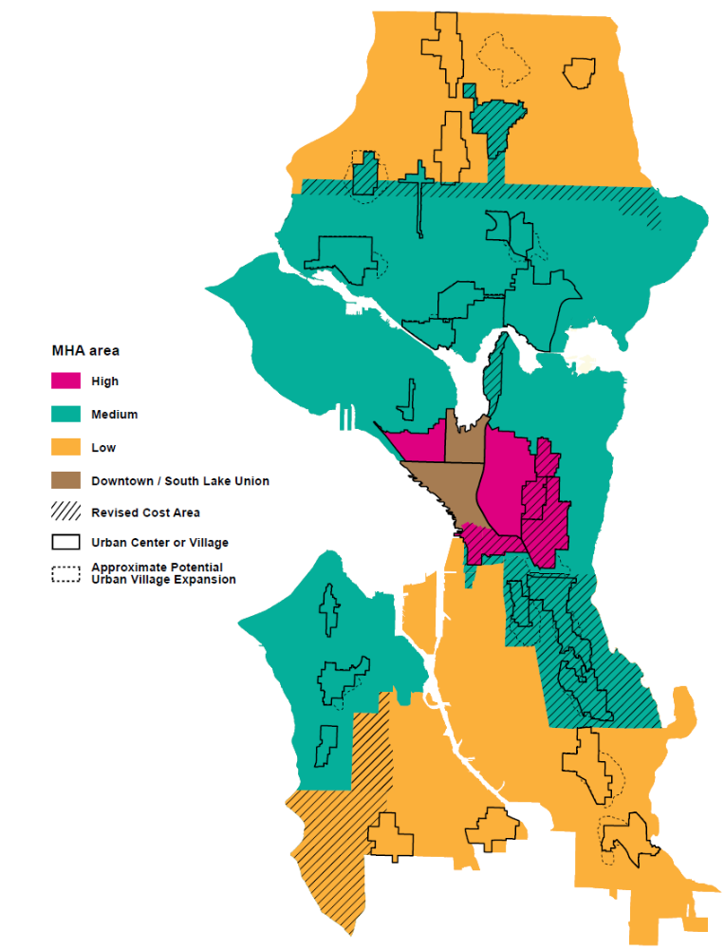
MHA in the CID Context
Affordability requirements vary across low/medium/high “MHA areas”
Communities with high risk of displacement on border between two areas moved to higher requirement
  Change made in response to community engagement and based on Growth & Equity Report

Slide 16
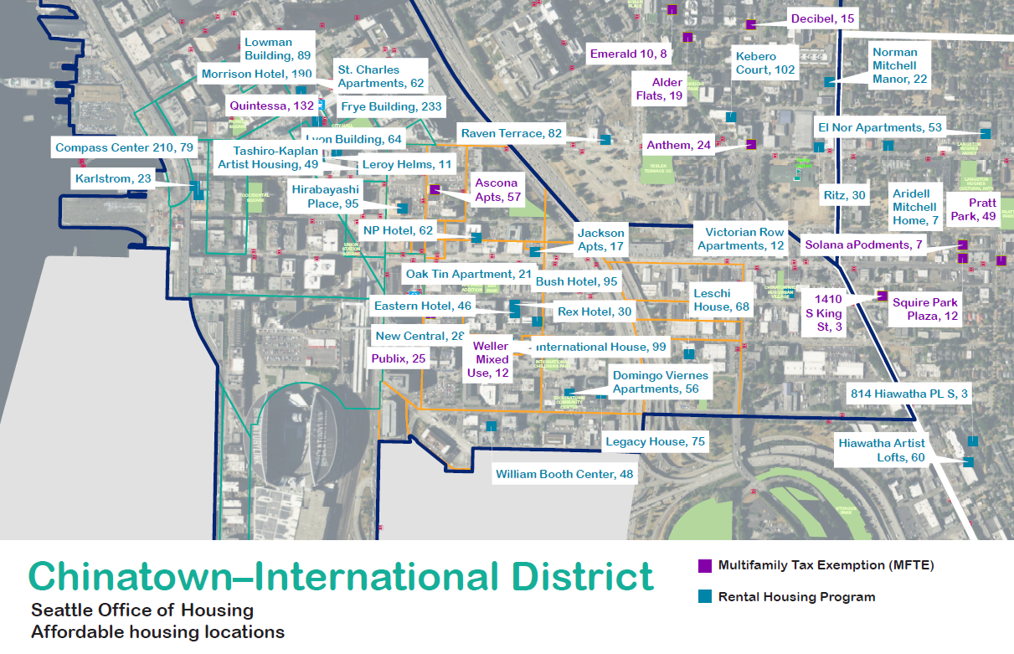
Affordable Housing in CID

