Slide 1
Mandatory Housing Affordability (MHA) in Chinatown/International District
Public Hearing
June 1, 2017
Notes:
JESSECA

Slide 2
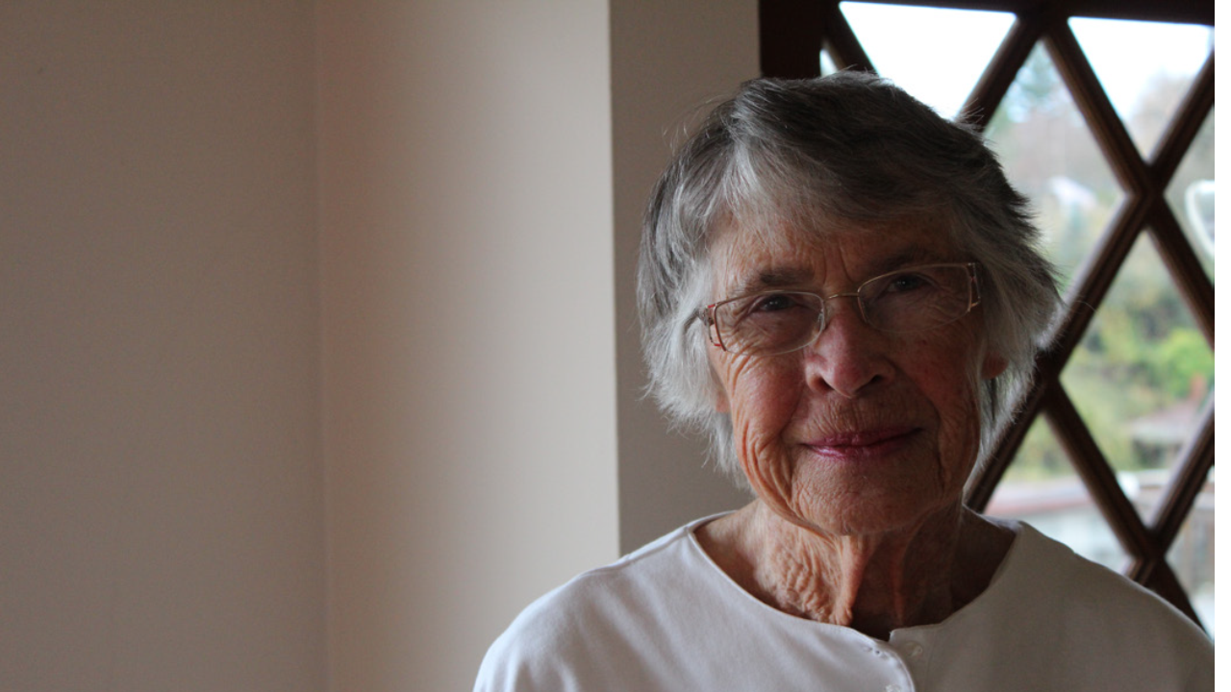
What is MHA?
Creating more affordable housing through growth
This new income- and rent-restricted housing would help our low income community members—such as seniors, artists, and working families.
Notes:
JESSECA
All new multifamily and commercial development must either build or pay into a fund for affordable housing
Provides additional development capacity to partially offset the cost of these requirements (zoning changes)
Increases housing choices
A state-approved approach other local cities have used

Slide 3
Livability
CID Framework and Implementation Plan
Public Safety Task Force
Hing Hay Park Expansion
Landmark Project
Street Concept Plans and Improvements
One Center City
Center City Connector
Updated Design Review Guidelines
Notes:
JESSECA

Slide 4
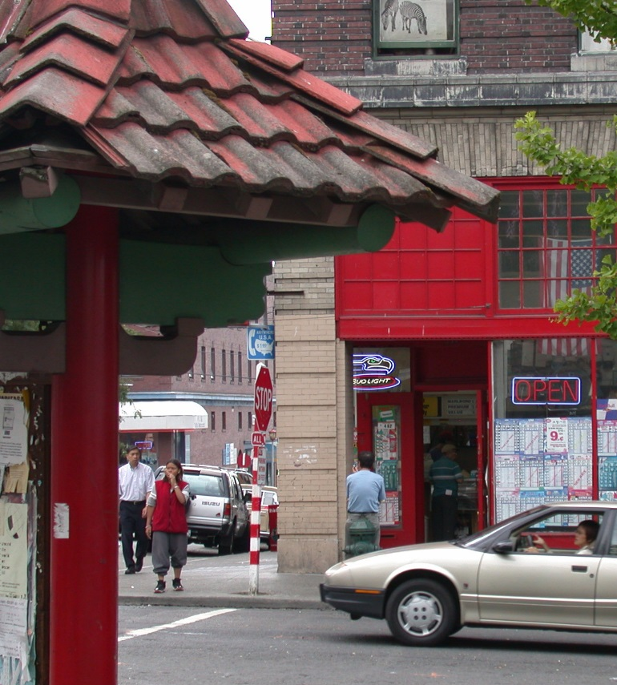
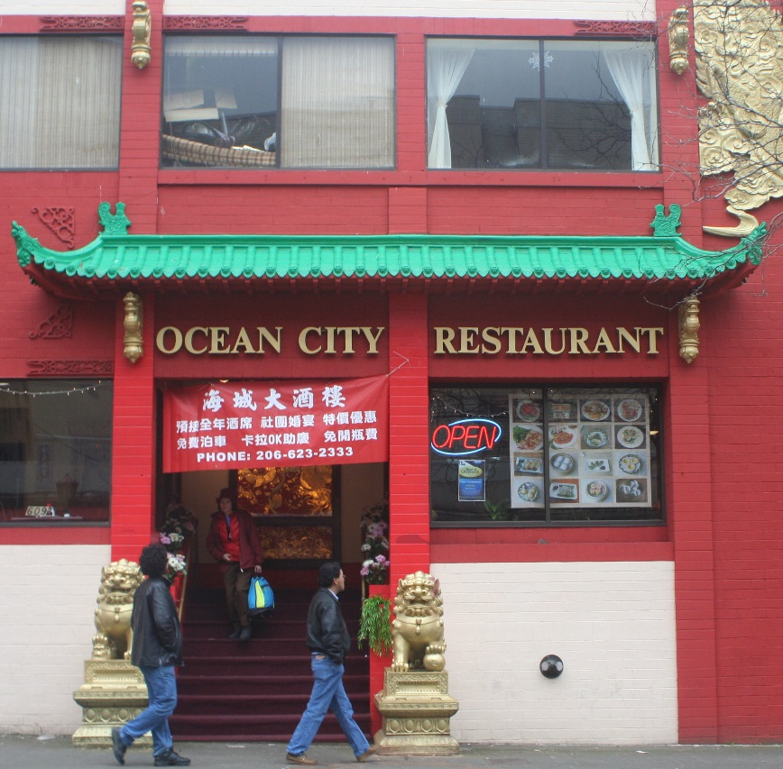
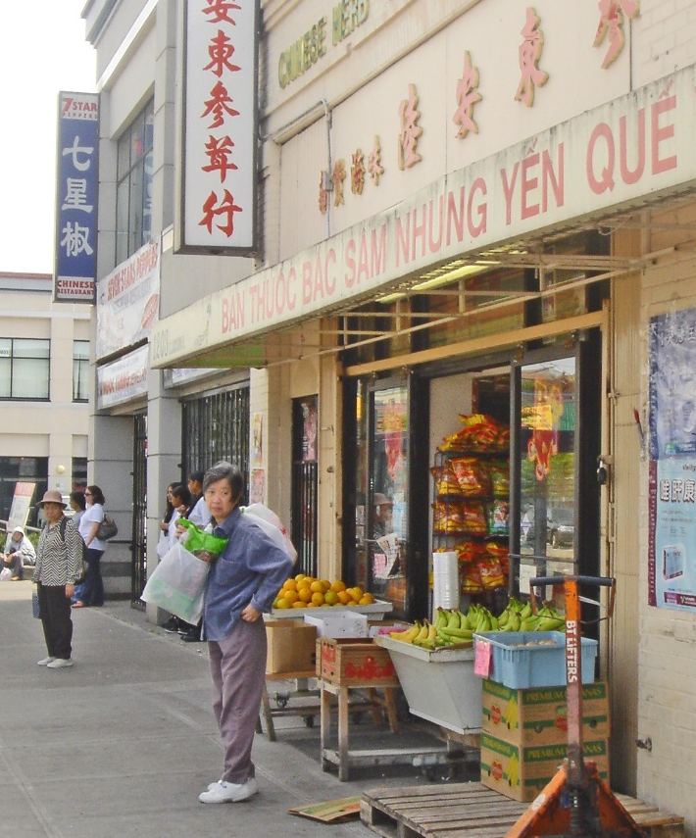
Context
2011 South Downtown Rezone
CID and Central Area are the only two areas where there is significant economic, physical, and cultural displacement
CID was separated from Downtown/SLU proposal in October 2016 because of area’s unique conditions
Notes:
JESSECA

Slide 5
Public Engagement
Part of Comprehensive Downtown/SLU outreach
We hosted two open houses and attended 15 meetings where the community already meets (4 in CID specifically).
What we heard:
  Broad support for basic concept
  Desire for more market-rate and affordable housing in CID
  Preference for taller rather than wider buildings
  Concern about historic areas
How it changed the proposal:
  Extra capacity changed from extra width to extra height
  Historic Districts exempted
Notes:
JESSECA
Released initial proposal in November 2015
February 24th and March 21st Open Houses (2016)
Presentations and Discussions with 15 neighborhood and stakeholder groups
Summary of Comments and Proposed Response posted May 24th, 2016
Comment Period through mid-June 2016

Slide 6
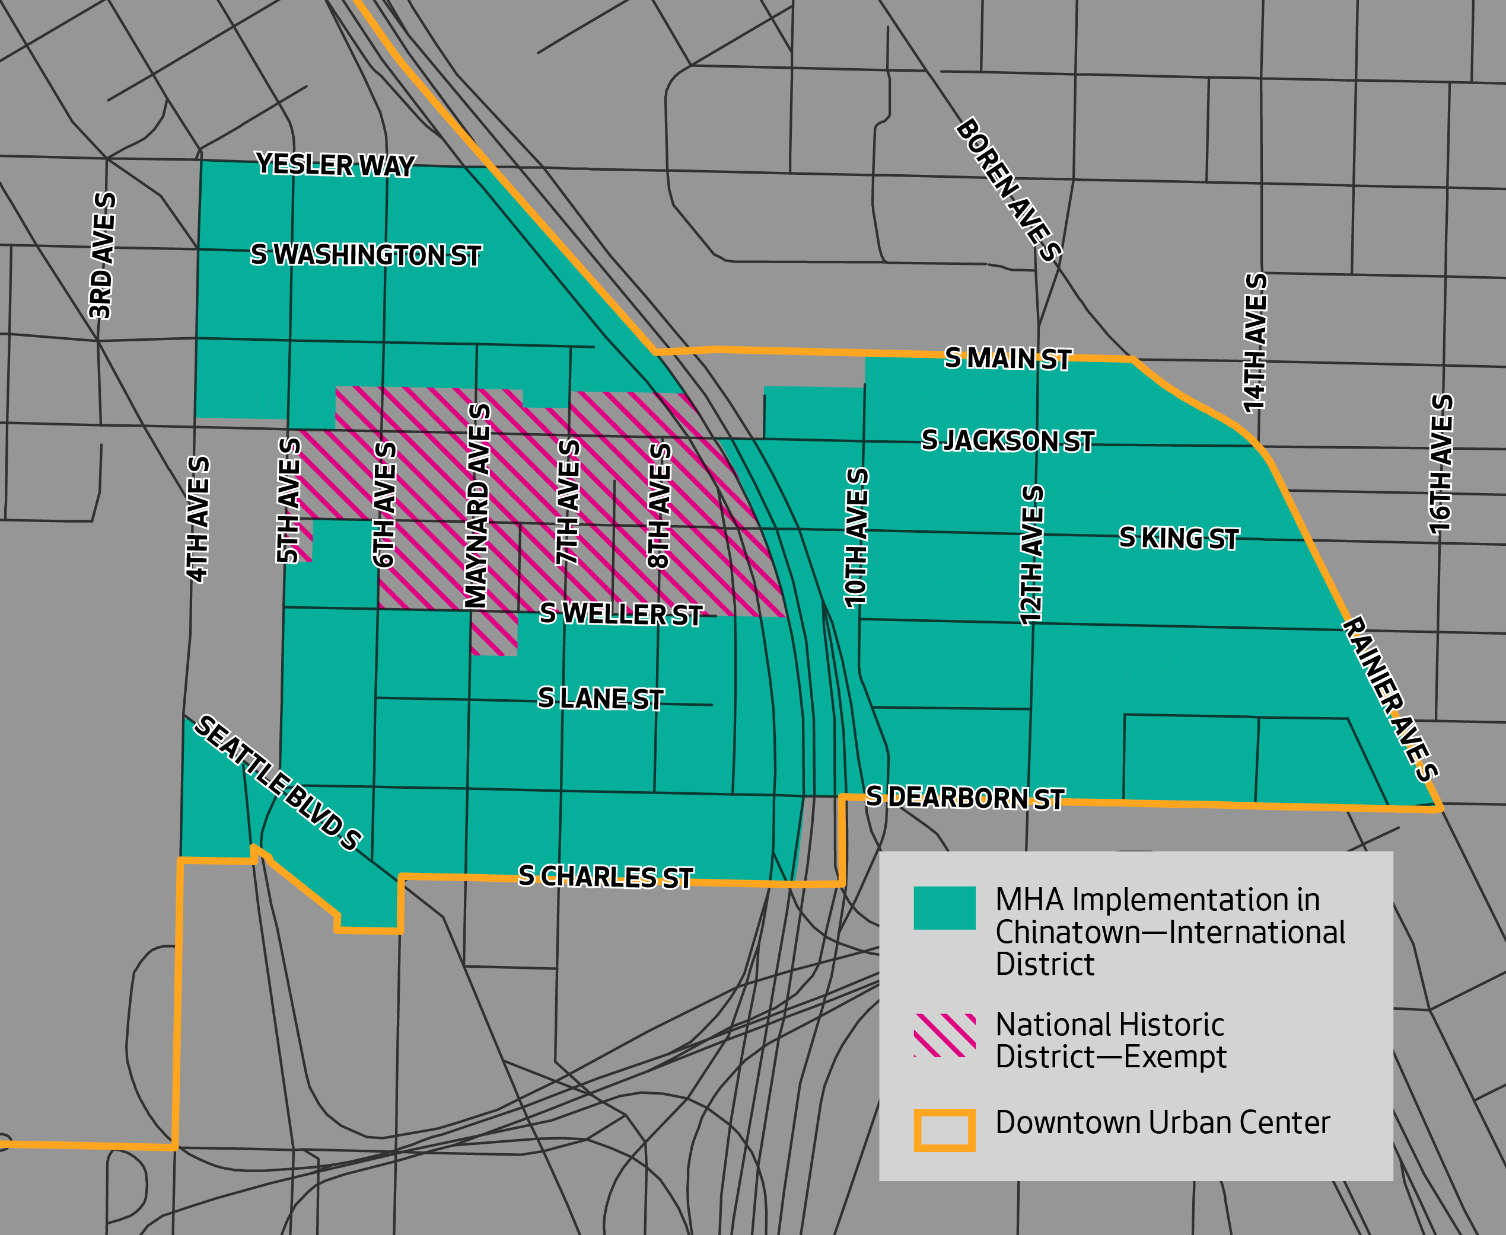
Areas where MHA would apply
Notes:
BRENNON

Slide 7
Additional Capacity
Varies by Zone
Commercial: Additional 0.5 to 1.0 FAR
Residential Towers: Additional Height
Increasing minimum tower floor plate from 8,000 to 8,800 where applicable
In Little Saigon, base height was increased by 10 feet
Zones | Capacity Increase
Zones with heights of 85 feet or less | 10 feet
Zones with heights of 150 or feet | 20 feet
Zones with heights of 240 feet | 30 feet
Notes:
BRENNON

Slide 8
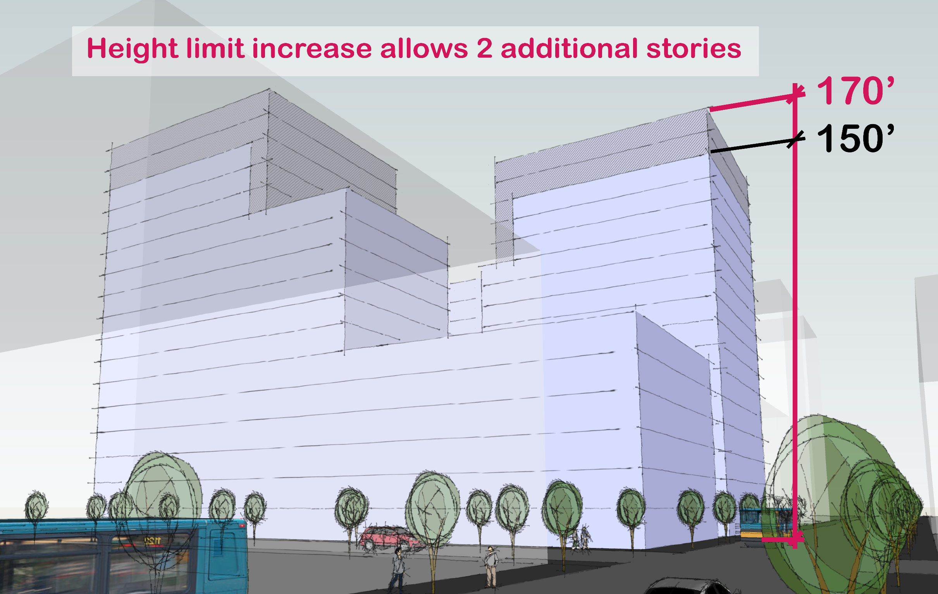
DMR/C 65/65-150 Residential
Notes:
BRENNON

Slide 9
MHA requirements
Requirements vary:
 | Payment | Performance
Residential uses | $20.75 | 7.0%
Commercial in zones with heights more than 85 feet | $20.75 | 7.0%
Commercial in zones with heights 85 feet or less | $8.00 | 5.0%
Estimated to result in 150 affordable housing units over 10 years
Notes:
BRENNON
Downtown/SLU (All Payment):$130M from commercial and $60M from residential development over 10 years

Slide 10
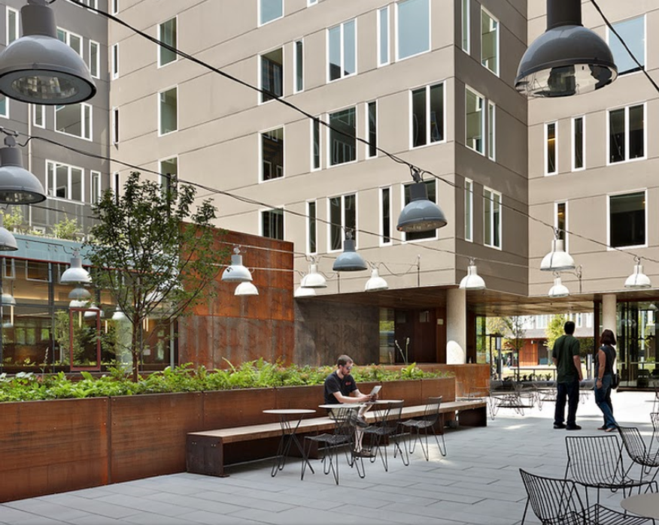
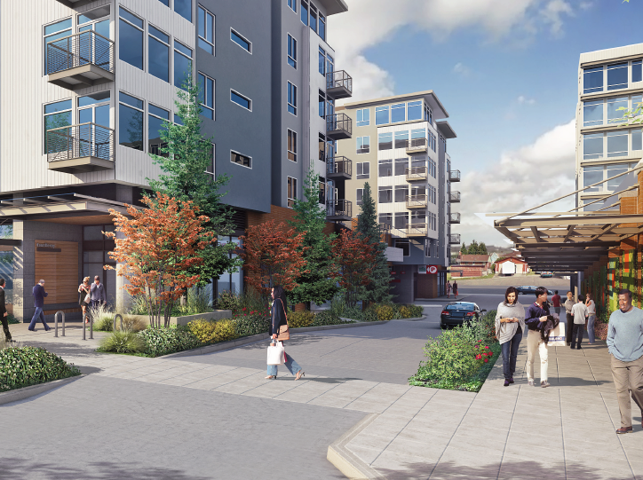
Incentive Zoning
In addition to affordable housing, to reach the maximum heights projects must:
  Acquire TDR from open space, landmarks,
  Provide Privately Owned Public Space (POPS); or
  Provide green street improvements
Commercial properties also contribute to childcare
Notes:
BRENNON

Slide 11
MHA Payment and Performance Examples
Project example | Requirement | Performance outcome | Payment outcome
12-story commercial tower IDM 165/85-170 Half block 200,000 gross commercial square feet | 7.0% or $20.75 per sq. ft. + Incentive Zoning | 16 affordable homes | 47 affordable homes ($4.1M)
 |  | $0.5M in TDR, POPS, or combination
17-story residential tower DMR/C 75/75-170 Third of a block 400 total homes 400,000 gross residential square feet | 7.0% or $20.75 per sq. ft. + Incentive Zoning | 28 affordable homes | 93 affordable homes ($8.3M)
 |  | $1.5M in TDR, POPS, or combination
Notes:
BRENNON

Slide 12
Displacement
Creating new affordable housing choices is a critical anti-displacement strategy:
  Proposal will result in estimated 150 new income- and rent-restricted homes over the next 10 years. These affordable homes will help support low-income residents across the city.
The proposal will not substantially change likelihood of direct displacement:
  Scale of proposed additional capacity is not expected to significantly change the likelihood that parcels will redevelop.
  National Historic Register District is exempt from proposal.
Notes:
EMILY

Slide 13
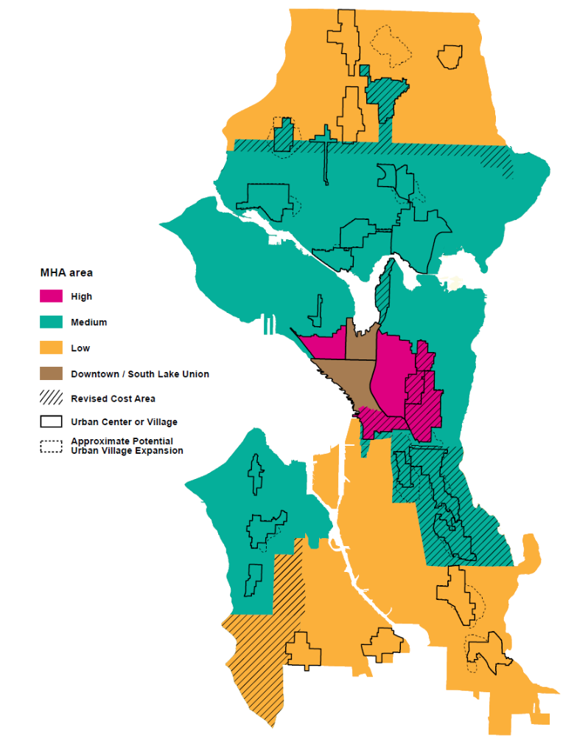
MHA in the CID Context
Affordability requirements vary across low/medium/high “MHA areas”
Communities with high risk of displacement on border between two areas moved to higher requirement
  Change made in response to community engagement and based on Growth & Equity Report
Notes:
EMILY

Slide 14
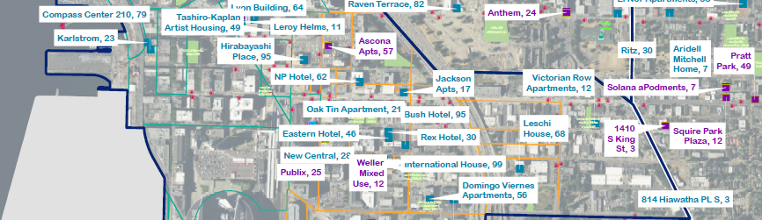
Use of Payment Revenue
Locational Goals
Furthering fair housing choice
Locating in urban centers and villages
Locating near transit
Promoting economic opportunity and addressing displacement
Locating near developments that generate cash contributions
Payment can help fund units at deeper level of affordability
Notes:
EMILY
Locational Criteria for IZ
Downtown Commercial IZ
Payments must be prioritized in the following order:
Within the Downtown Urban Center;
Within an Urban Center adjacent to the Downtown Urban Center;
In the city within 0.5 mile of a light rail or bus rapid transit station on a route serving the Downtown Urban Center;
In the city within 0.25 mile of a bus or streetcar stop on a route serving the Downtown Urban Center.
Downtown Residential IZ: No location criteria
Total development cost of $265,000 per unit
City funds leveraged 2.25:1 (4% LIHTC and tax exempt bonds)
Approximately $80,000 in City funds per 60% AMI unit
No other City or public funds
South Lake Union Commercial & Residential IZ: Housing for income-eligible households must be located within the Seattle city limits
Past production from payments under Incentive Zoning
$70.26 million committed to affordable housing
Rental: $68.05 million invested in 32 projects with 2,316 affordable units
This investment created 948 affordable rental units that would otherwise not have been built (estimated based on 4% LIHTC projects)
Among 4% LIHTC projects, City funds were leveraged 3:1
Ownership: $2.21 million invested in 41 homes
Future modeling assumptions for MHA
Total development cost of $265,000 per unit
City funds leveraged 2.25:1 (4% LIHTC and tax exempt bonds)
Approximately $80,000 in City funds per 60% AMI unit
No other City or public funds

Slide 15
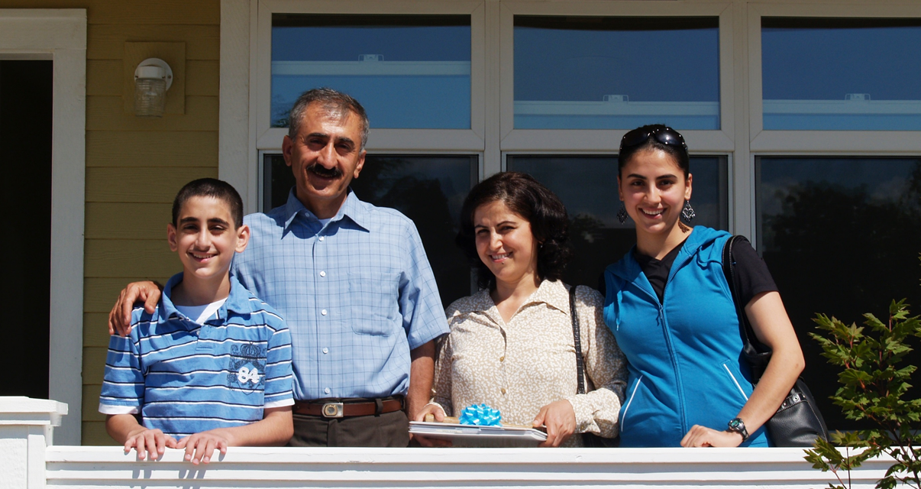
6,000 new affordable homes
Notes:
EMILY
Recap slide. This proposal is essential to our reaching the 6,000 new homes for low-income members of our community.

Slide 16
Notes:
EMILY

