Slide 1
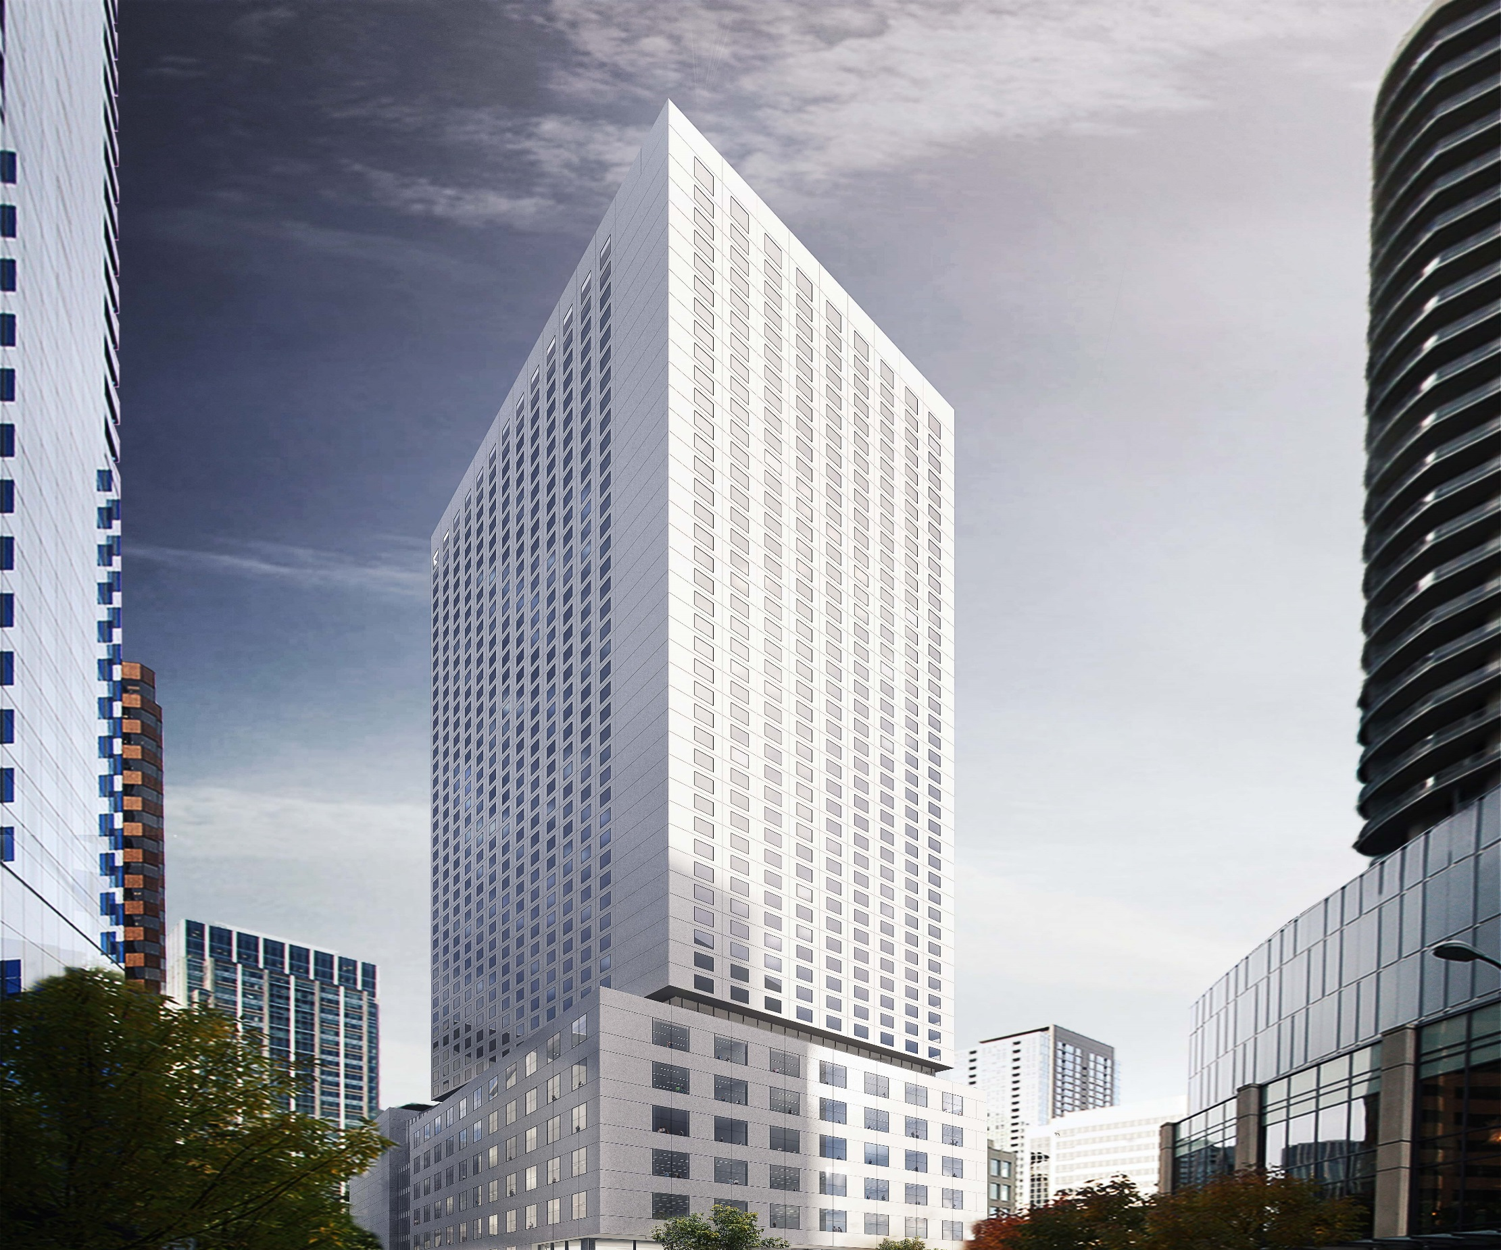

HT Seattle Owner, LLC
Pedestrian Tunnels Term Permit
City Council Sustainability & Transportation Committee
Amy Gray
January 19, 2018

Slide 2
Our mission, vision, and core values
Mission: deliver a high-quality
transportation system for Seattle
Vision: connected people, places, and products
Committed to 5 core values to create a city that is:
Safe
Interconnected
Affordable
Vibrant
Innovative
For all
2
Notes:
Our core values for transportation anchor to the core values that Mayor Murray has laid out in his vision (Move Seattle) for Seattle:
Safe
Interconnected
Affordable
Vibrant
Innovative

Slide 3
Proposal
HT Seattle Owner, LLC is seeking conceptual approval of two new pedestrian tunnels under the alley west of 9th Ave, south of Stewart St
These tunnels provide:
  Circulation and transportation of supplies, food, and laundry between the two hotel buildings; and
  Less impactful of surface alley
SDOT recommends approval of the resolution
3

Slide 4
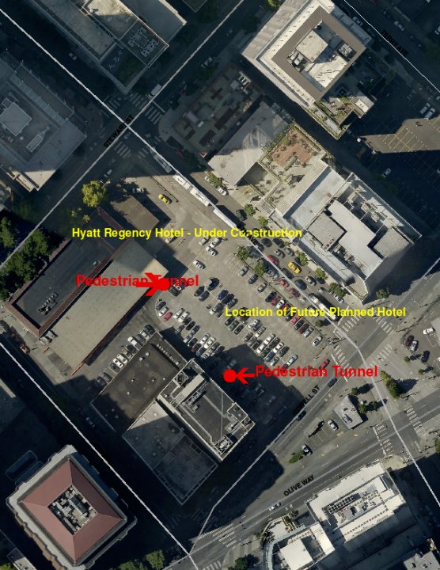
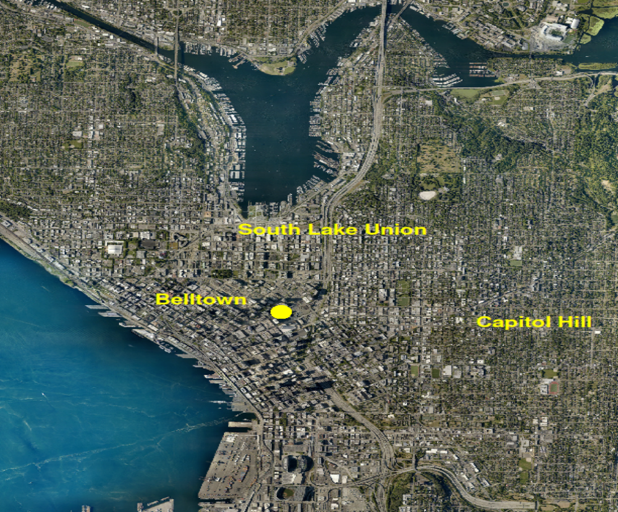

Project area
808 Howell St
4

Slide 5


Term permit process
  Step 1: Resolution
  Adoption of the resolution provides conceptual approval for the private use in the right-of-way, subject to the terms and conditions to be established in the term permit ordinance
  Step 2: Ordinance
  Passage of the ordinance details the terms and conditions of the permit, including annual fee, maintenance obligations, indemnification, insurance, and bond requirements
5

Slide 6
Requested Action
  SDOT is seeking City Council approval of this legislation which conceptually approves of the proposed installation in the right-of-way.
  Following the adoption of the resolution, SDOT will work with HT Seattle Owner, LLC on the terms and conditions of the ordinance to be transmitted in Q1 2018 for City Council consideration.
6

Slide 7





Questions?
Amy.Gray@seattle.gov | (206)-386-4638
www.seattle.gov/transportation

